Slide 1
Unsupervised Learning
291K Machine Learning
Lei Li and Yu-xiang Wang
UCSB
Some slides borrowed from Eric Xing, Arti Singh

Slide 2
Recap
Linear Regression
Linear classifier
Both need pairs of data-labels <x, y> to train
What if we do not have labels y
Can we still train a model to predict data class?

Slide 3
Unsupervised Learning
Basically finding “patterns” of data
No golden labels to teach the model
Only raw data x, but not y
Instances:
Clustering: Give data samples, find groupings
Dimensionality Reduction: Given high-dimensional data, compress them into low-dimensions

Slide 4
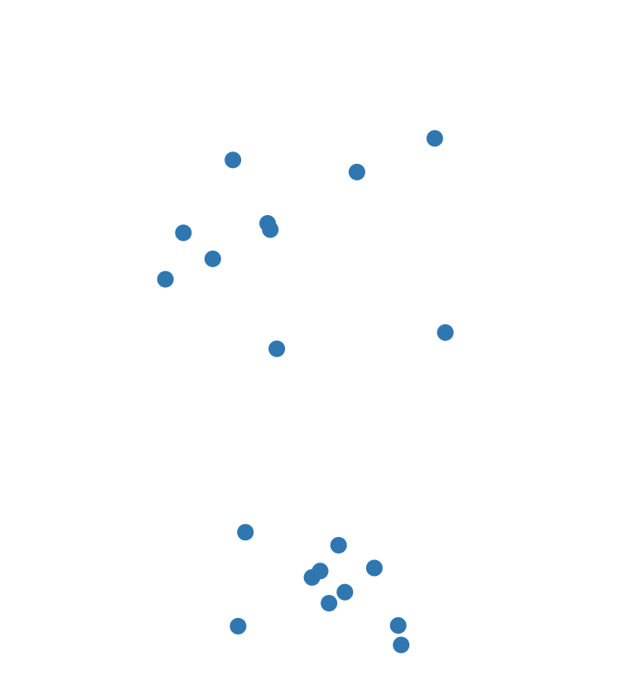
Why Unsupervised Learning
No human annotated data (too expensive)
Do not have clear target, but still want to find “meaningful” patterns
Just fitting the data with most likely distribution

Slide 5
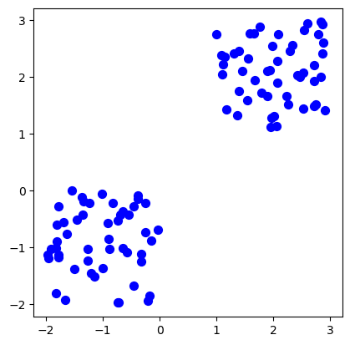
Clustering
Informally: find natural groups of data
Organizing data into clusters such that
High intra-cluster similarity
Low inter-cluster similarity

Slide 6
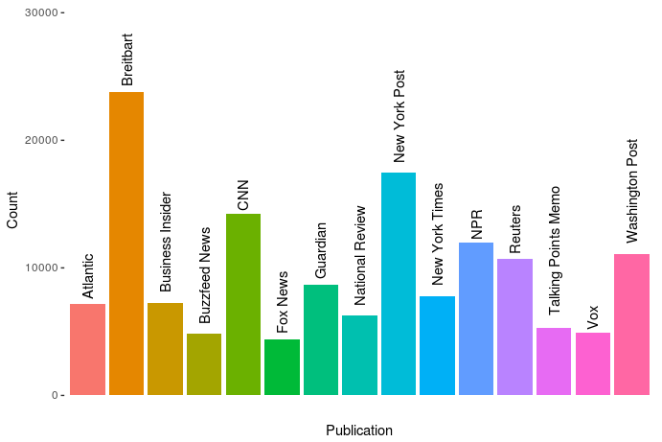
Grouping News Articles
Benjamin Netanyahu Questioned in Israel Graft Inquiry
Rockefeller Foundation Picks Rajiv J. Shah, a Trustee, as President
lare Hollingworth, Reporter Who Broke News of World War II, Dies at 105
Danielle Brooks: The First Time I Saw Myself on a Billboard
For Troubled Student, a Change of School and Direction
10 Key Moments and More From Trump’s News Conference
California Today: The Tale of the Laguna Beach Jumper

Slide 7
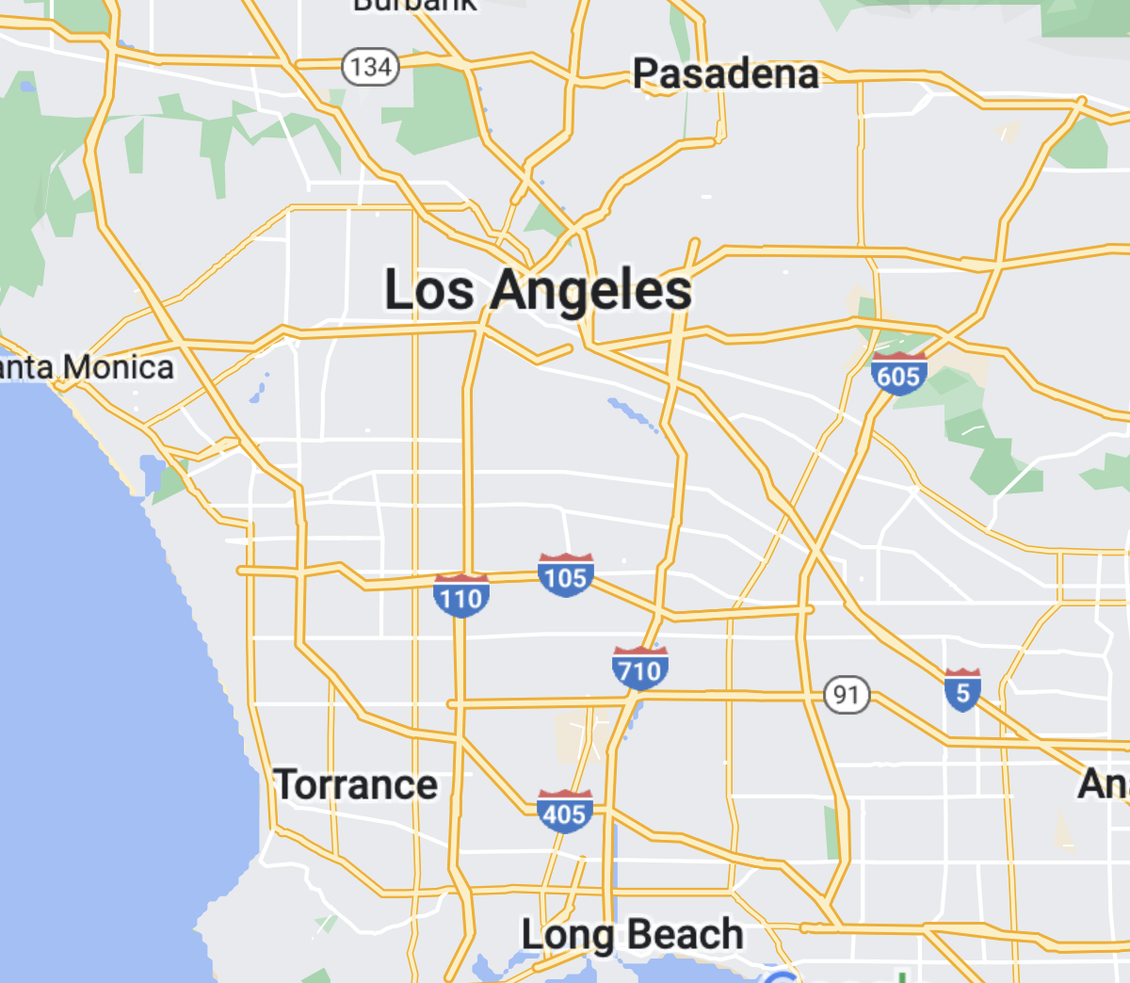
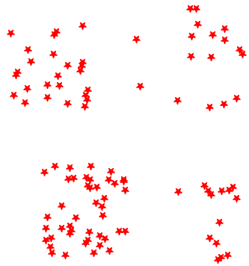
Choosing Pizza store sites
Pizza Hero wants to open a few stores at Los Angeles.
Through survey they collected pizza ordering requests from locations across the city.
How to decide the proper sites?

Slide 8
Why Clustering?
Organizing data into clusters provides better interpretation of the data
Reveal internal structure of data samples
Partition the data itself can be the goal
Image segmentation: separating objects from background
Knowledge discovery in data
E.g. reoccurring patterns, topics, etc.

Slide 9
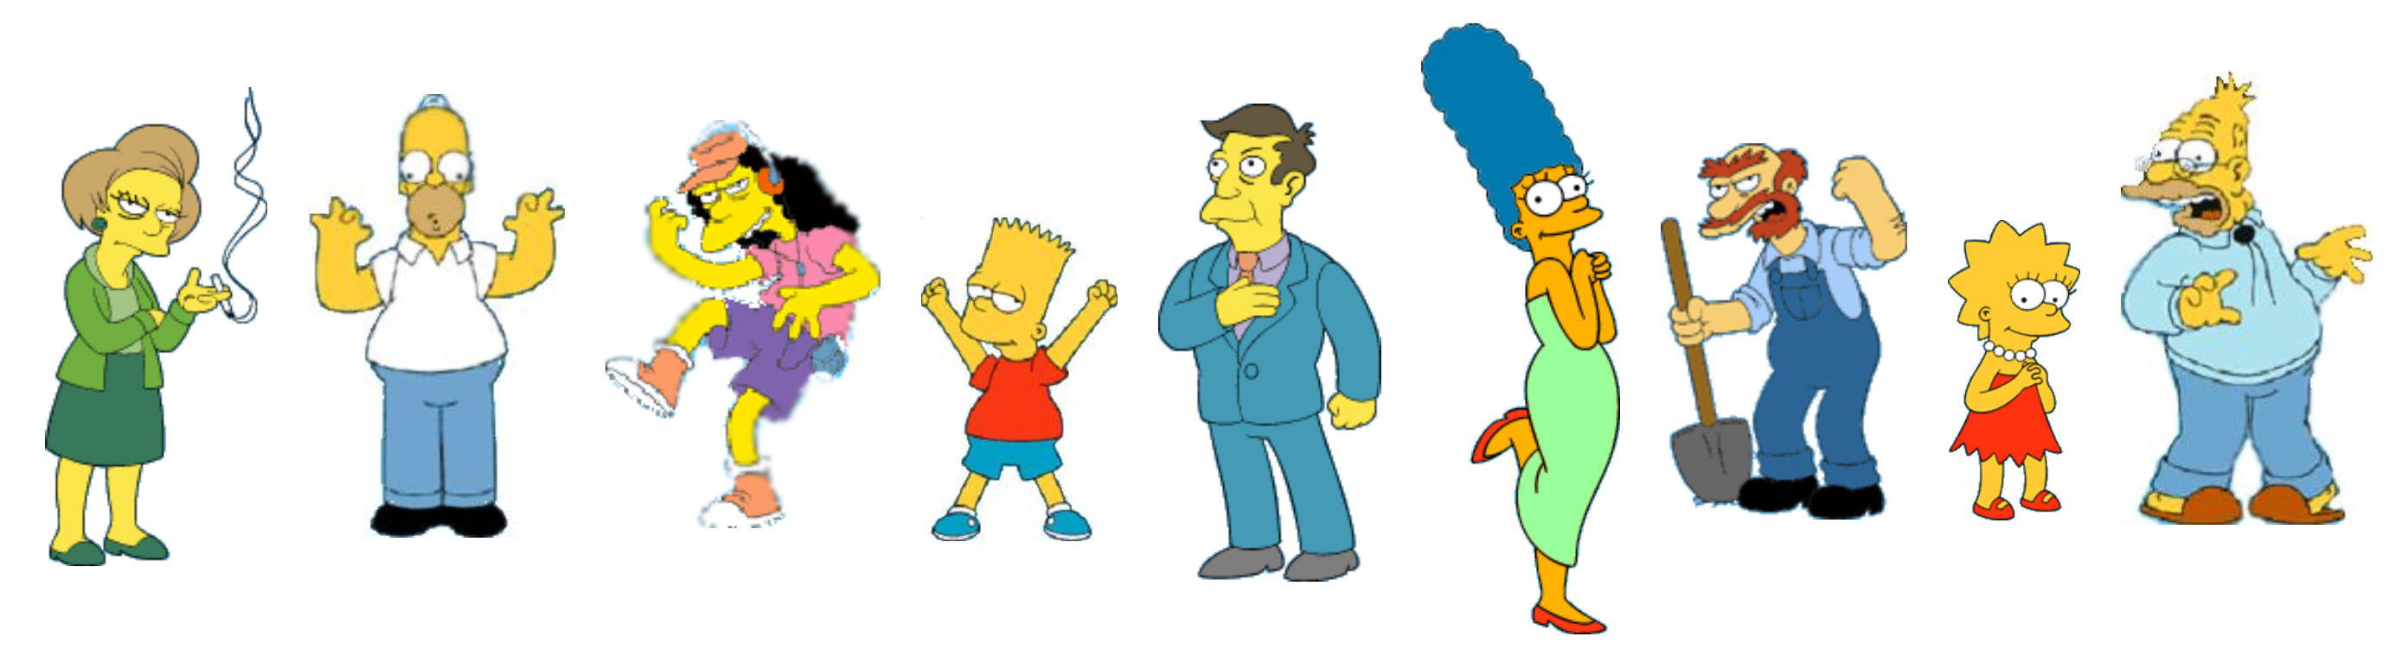
What is a natural grouping among these objects?

Slide 10
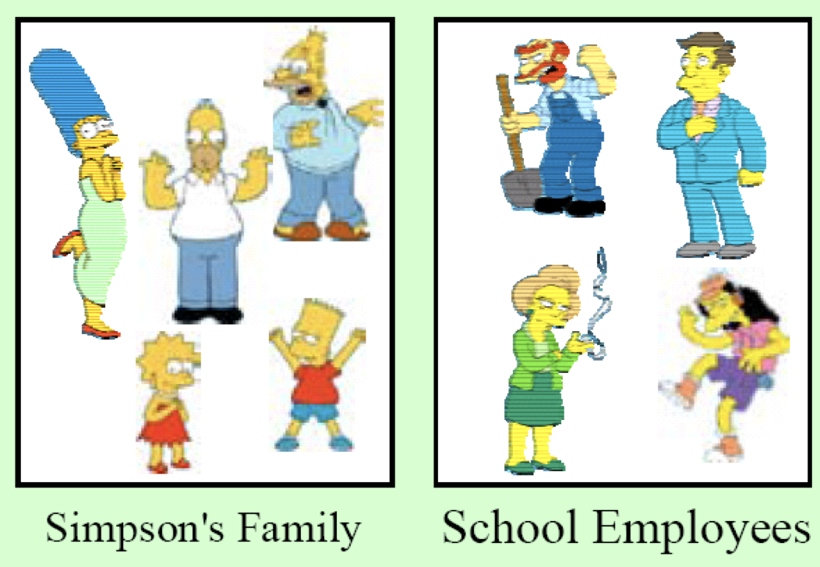
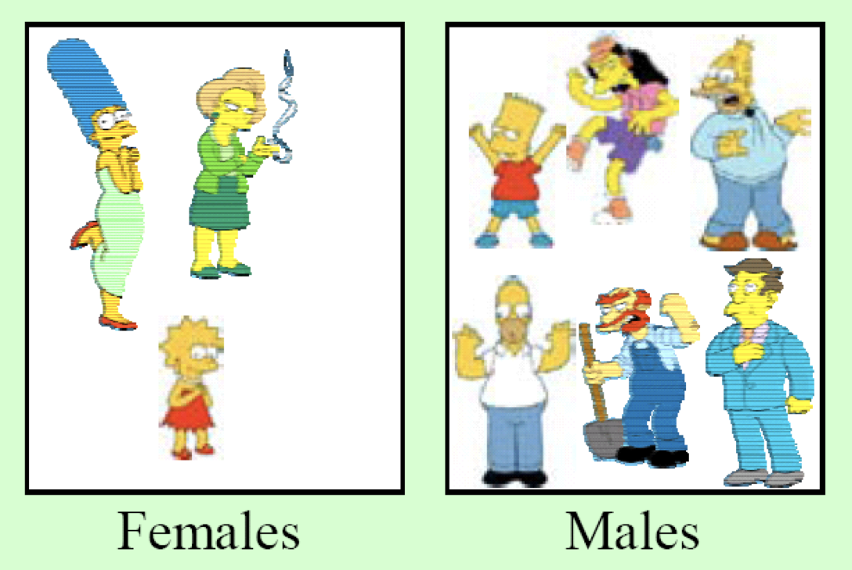
Clustering is subjective

Slide 11
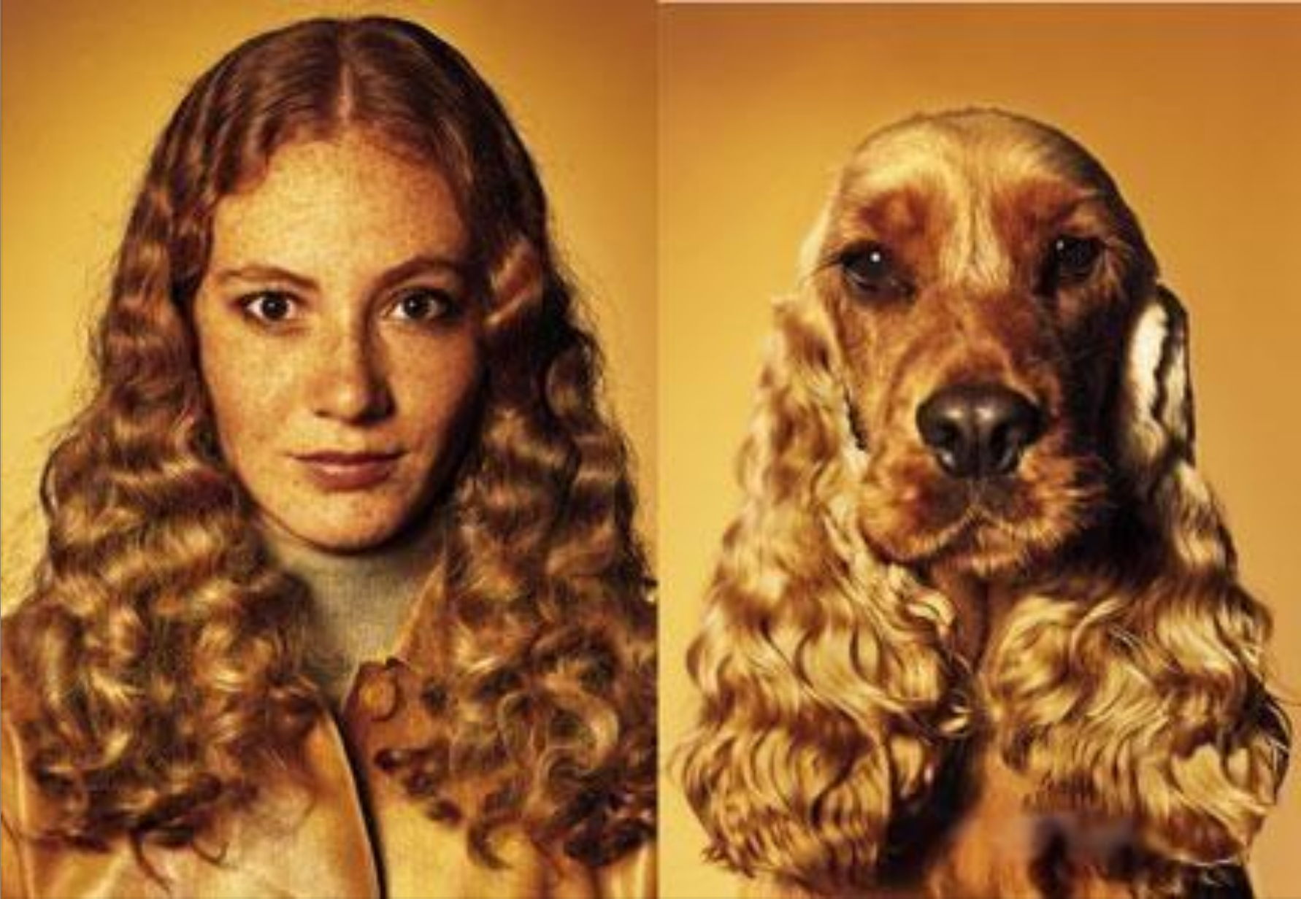
How to measure Similarity?
Similarity is hard to define. But we know it when we see it.
The real meaning of similarity is a philosophical question. We will take a more pragmatic approach - think in terms of a distance (rather than similarity) between vectors or correlations between random variables.

Slide 12
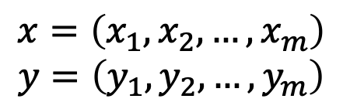
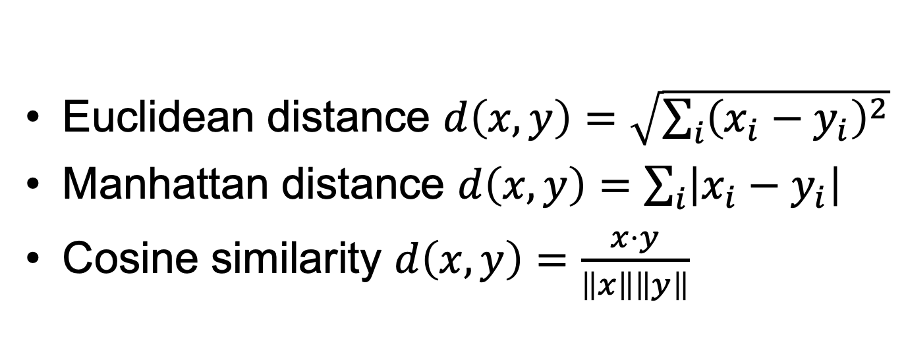
Distance Metrics
$$x=\left(x_{1},x_{2},…,x_{m}\right)$$
$$y=\left(y_{1},y_{2},…,y_{m}\right)$$
3
4
Euclidean distance $d\left(x,y\right)=\sqrt{\sum_{i}{{\left(x_{i}−y_{i}\right)}^{2}}}$
Manhattan distance $d\left(x,y\right)=\sum_{i}{\left|x_{i}−y_{i}\right|}$
Cosine similarity $d\left(x,y\right)=\frac{x⋅y}{\left\|x\right\|\left\|y\right\|}$
5
7

Slide 13
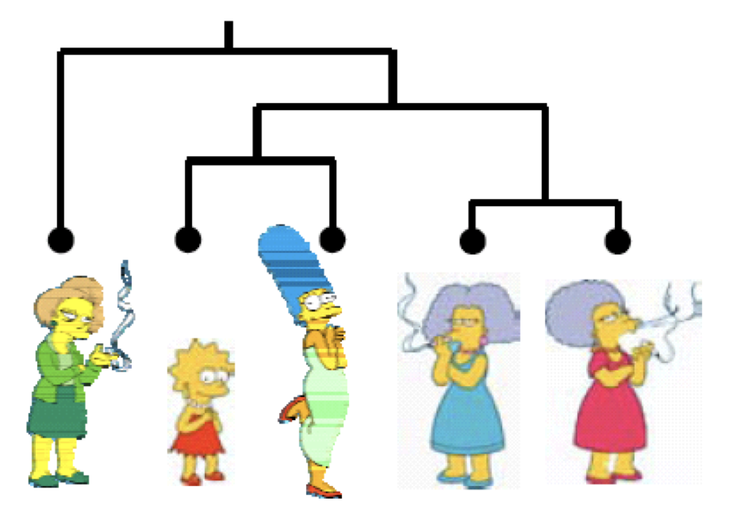
Types of Clustering
Partition algorithms
K-means clustering
Spectral clustering
Mixture-model
Hierarchical algorithms
Bottom-up
Top-down

Slide 14
Desirable Properties of Clustering Algorithm
Scalability
General
No requirement for domain knowledge
Interpretability and Usability

Slide 15
K-Means Clustering
Group N data samples (m-dimensional) into K non-overlapping groups
The user has to specify K the number of clusters.

Slide 16
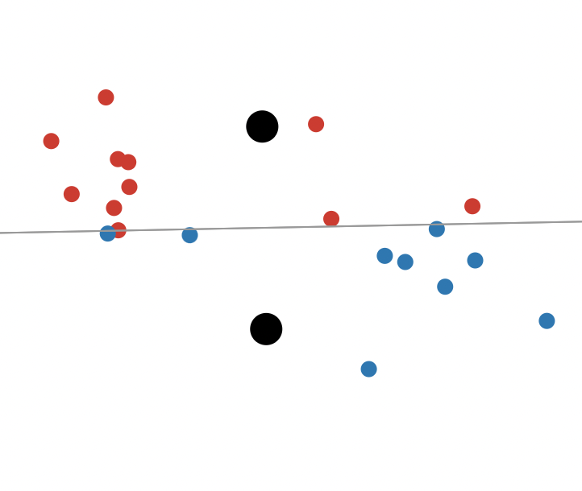
K-Means Clustering Algorithm
Start with initial K cluster centers randomly

Slide 17
K-Means Clustering Algorithm
Assign each data point to its nearest center

Slide 18
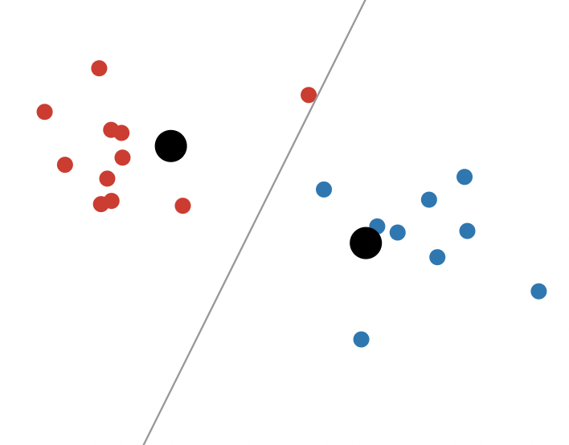
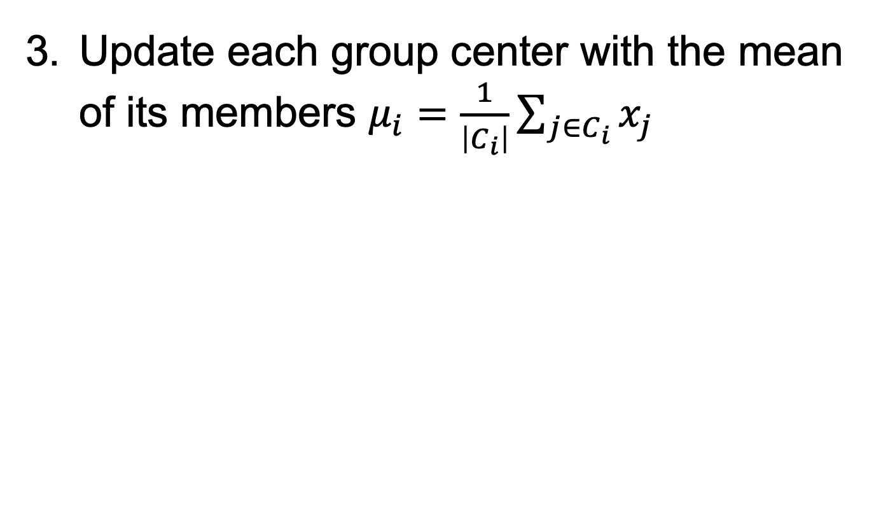
K-Means Clustering Algorithm
Update each group center with the mean of its members $μ_{i}=\frac{1}{\left|C_{i}\right|}\sum_{j∈C_{i}}{x_{j}}$

Slide 19
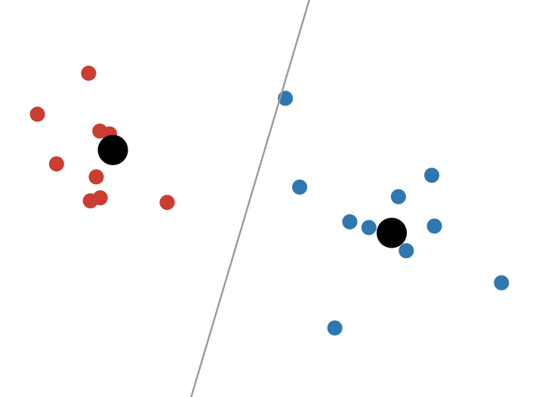
K-Means Clustering Algorithm
Repeat steps 2-3 with many iterations.

Slide 20
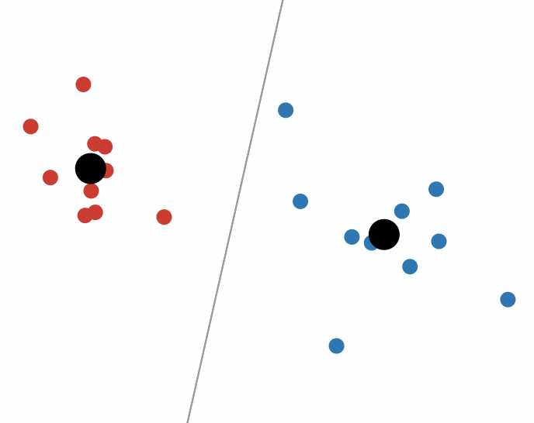
K-Means Clustering Algorithm
Finish when members in clusters do not change.

Slide 21
K-Means Algorithm
Start with initial K cluster centers randomly
Assign each data point to its nearest center using distance function
Update each group center with the mean of its members
Repeat steps 2-3 with many iterations until members in clusters do not change.
Demo:https://www.naftaliharris.com/blog/visualizing-k-means-clustering/

Slide 22
Variation – K-Medoids
Start with initial K cluster centers randomly
Assign each data point to its nearest center using distance function
Update the center with the point bearing the smallest total distance to all other points in the same cluster
Repeat steps 2-3 with many iterations until members in clusters do not change.

Slide 23
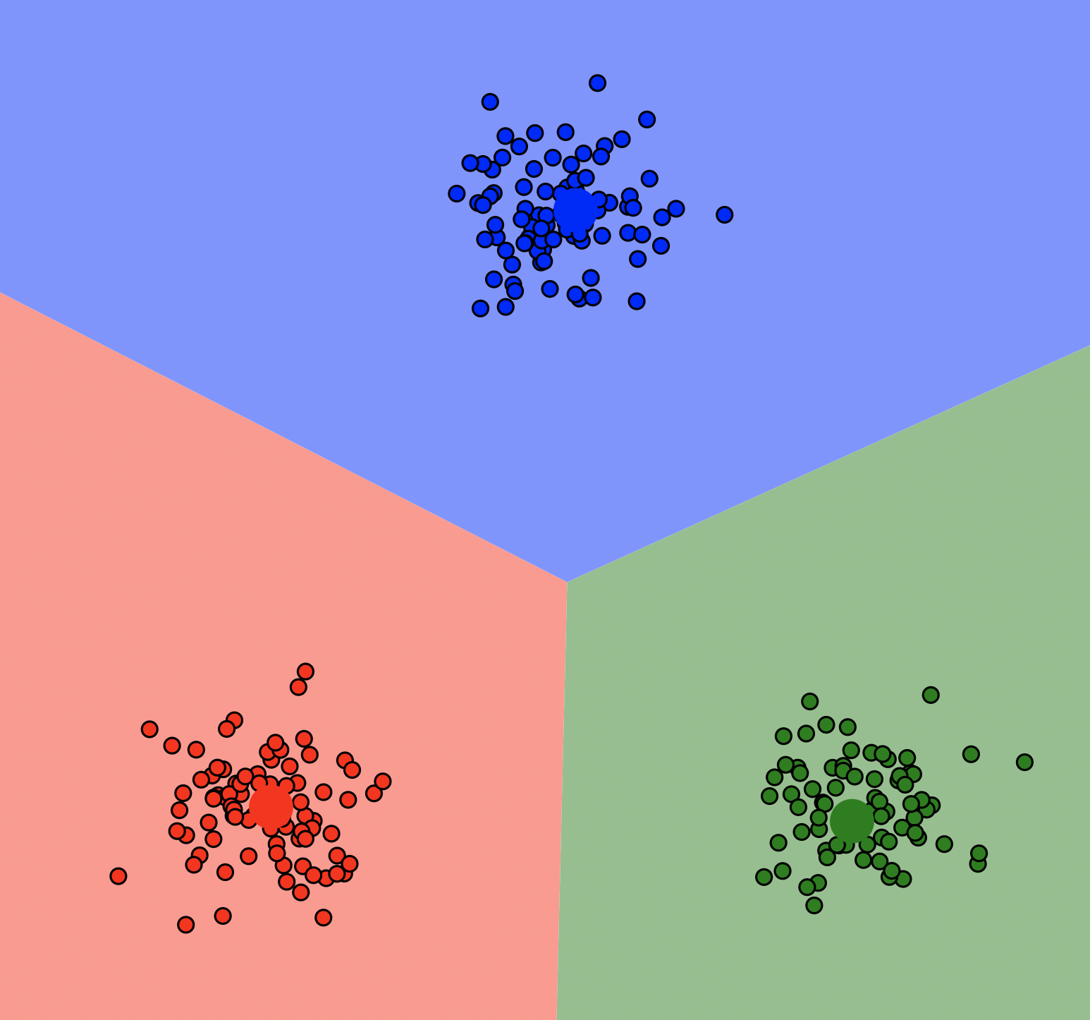
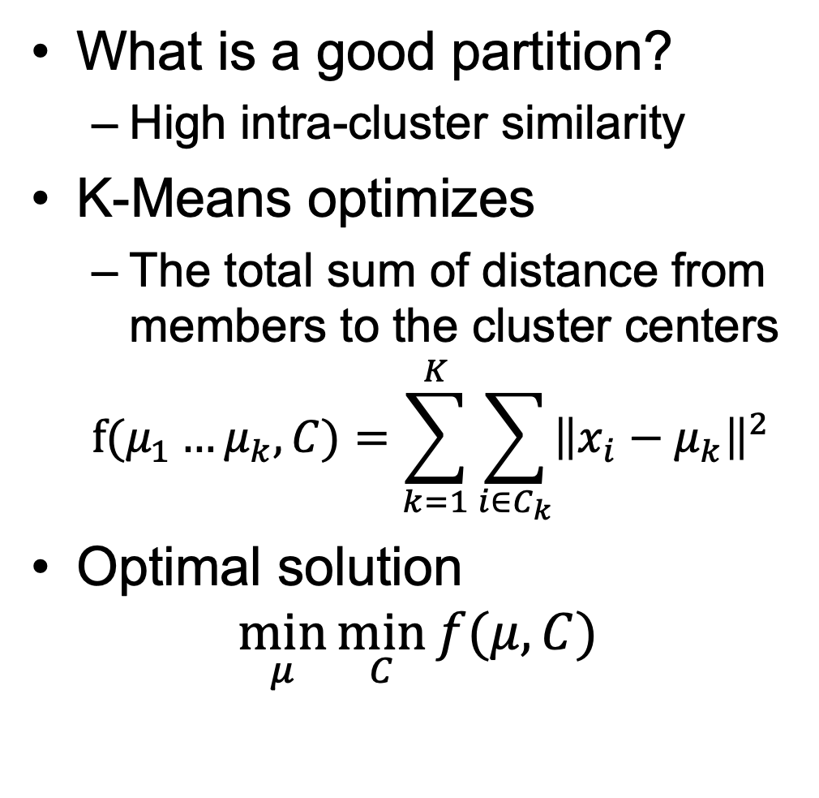
Why K-Means Works?
What is a good partition?
High intra-cluster similarity
K-Means optimizes
The total sum of distance from members to the cluster centers
$$f(μ_{1}…μ_{k},C)=\sum_{k=1}^{K}{\sum_{i∈C_{k}}{{\left\|x_{i}−μ_{k}\right\|}^{2}}}$$
Optimal solution
$$\min_{μ}{\min_{C}{f(μ,C)}}$$

Slide 24
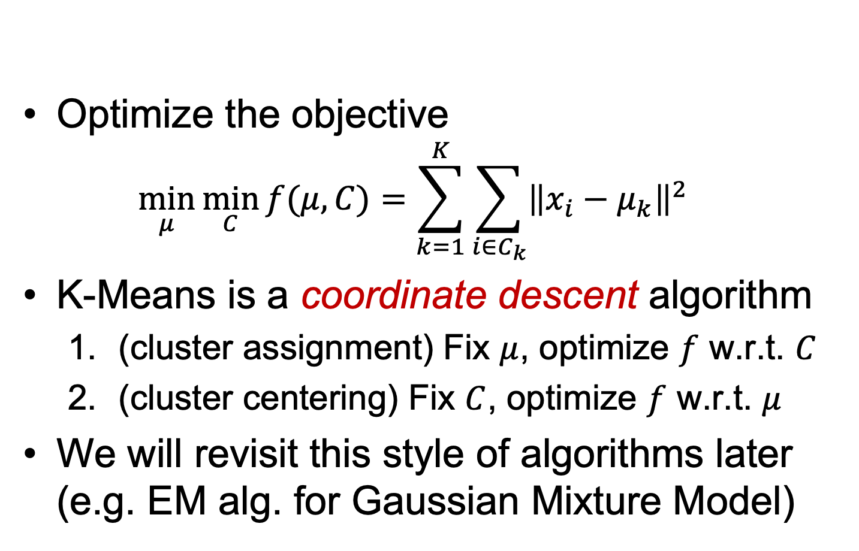
K-Means algorithm
Optimize the objective
$$\min_{μ}{\min_{C}{f(μ,C)}}=\sum_{k=1}^{K}{\sum_{i∈C_{k}}{{\left\|x_{i}−μ_{k}\right\|}^{2}}}$$
K-Means is a coordinate descent algorithm
(cluster assignment) Fix $μ$, optimize $f$ w.r.t. $C$
(cluster centering) Fix $C$, optimize $f$ w.r.t. $μ$
We will revisit this style of algorithms later (e.g. EM alg. for Gaussian Mixture Model)

Slide 25
Quiz
On Edstem

Slide 26
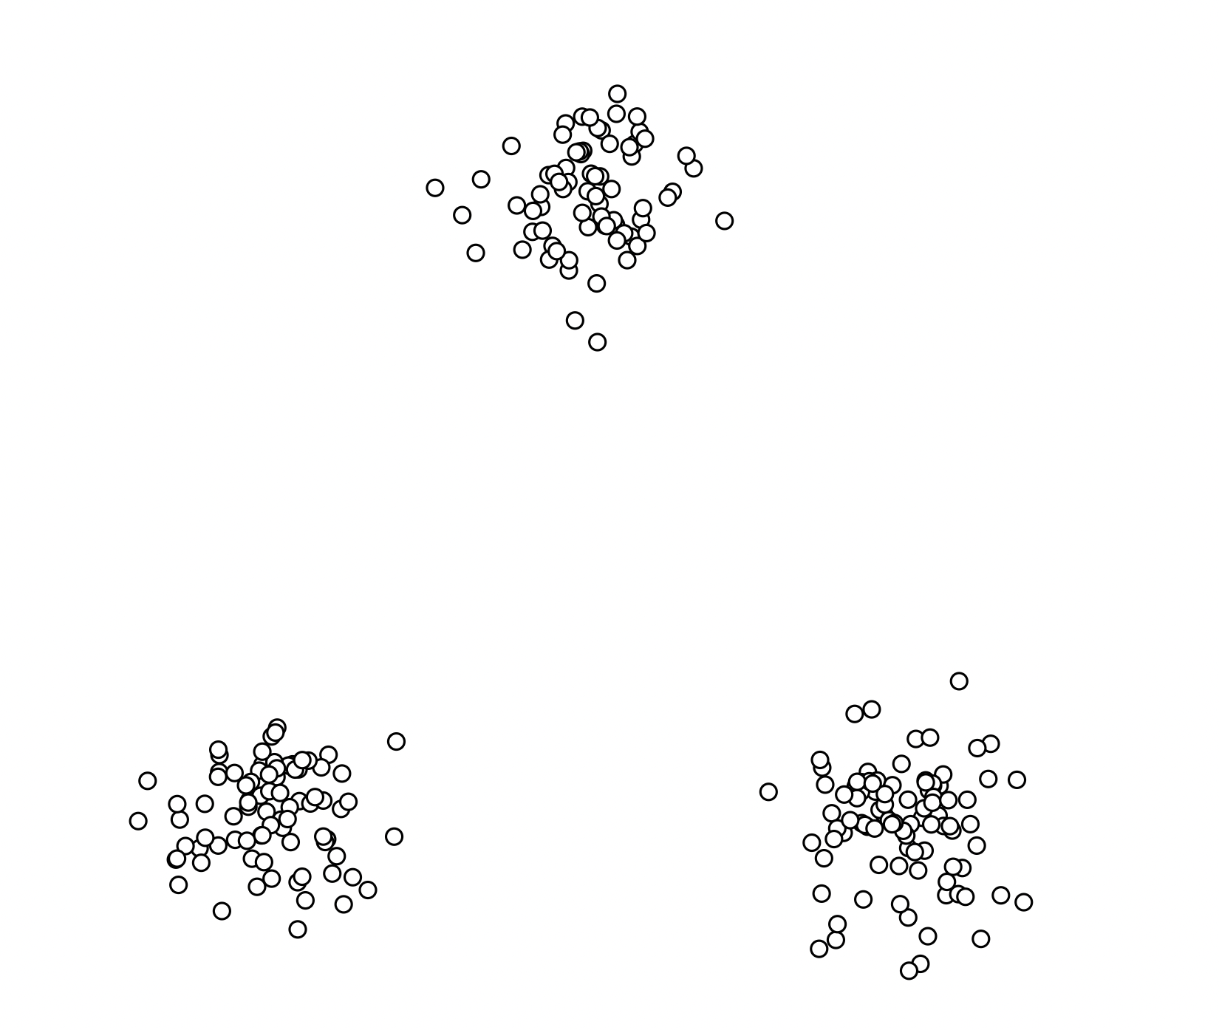
Seed Initialization
Results are quite sensitive to seed selection
Does k-means always succeed?
https://www.naftaliharris.com/blog/visualizing-k-means-clustering/
Try example for Gaussian Mixture

Slide 27
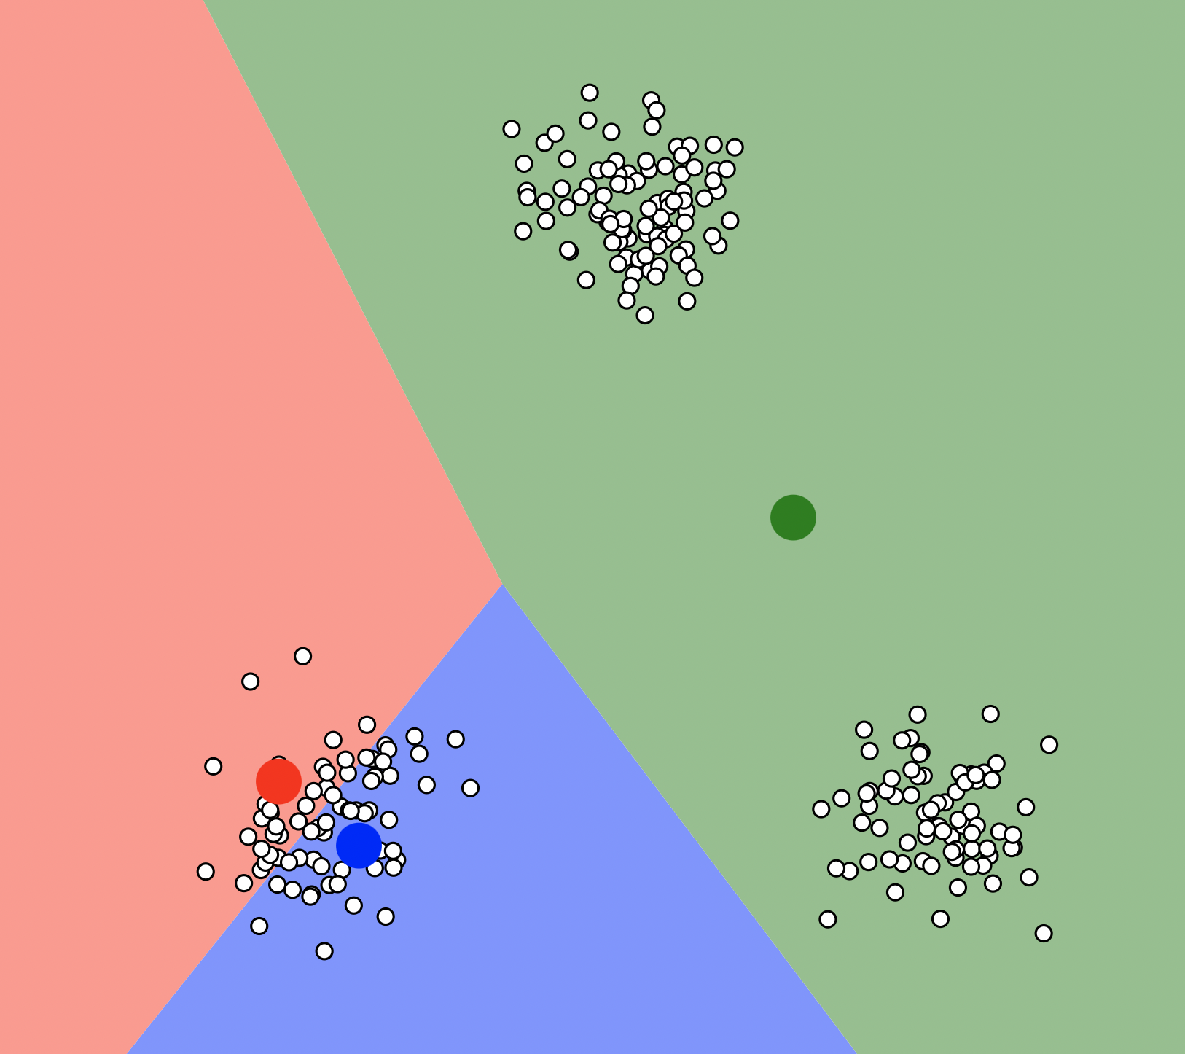
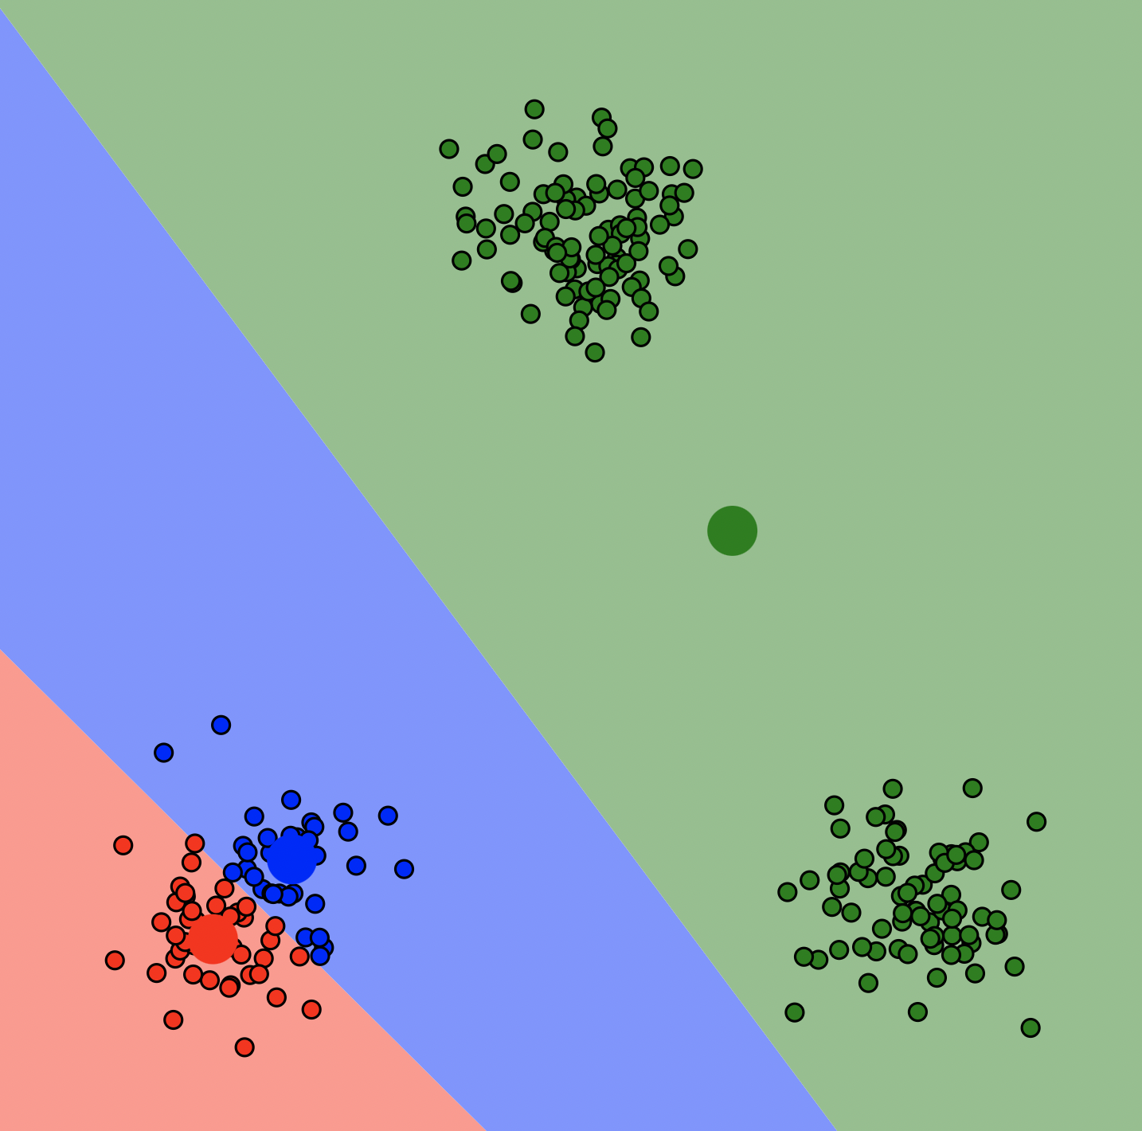
Seed Initialization
Results are quite sensitive to seed selection
https://www.naftaliharris.com/blog/visualizing-k-means-clustering/
Try example for Gaussian Mixture

Slide 28
Seed Initialization
Results can vary based on initial cluster assignments
Some initializations can result in poor convergence rate, or converge to a sub-optimal result
Try multiple starting points (very important!!!)
K-means++ algorithm
Key idea: initialize centers that are far apart
David Arthur and Sergei Vassilvitskii, K-means++: the advantages of careful seeding. SODA 2007

Slide 29
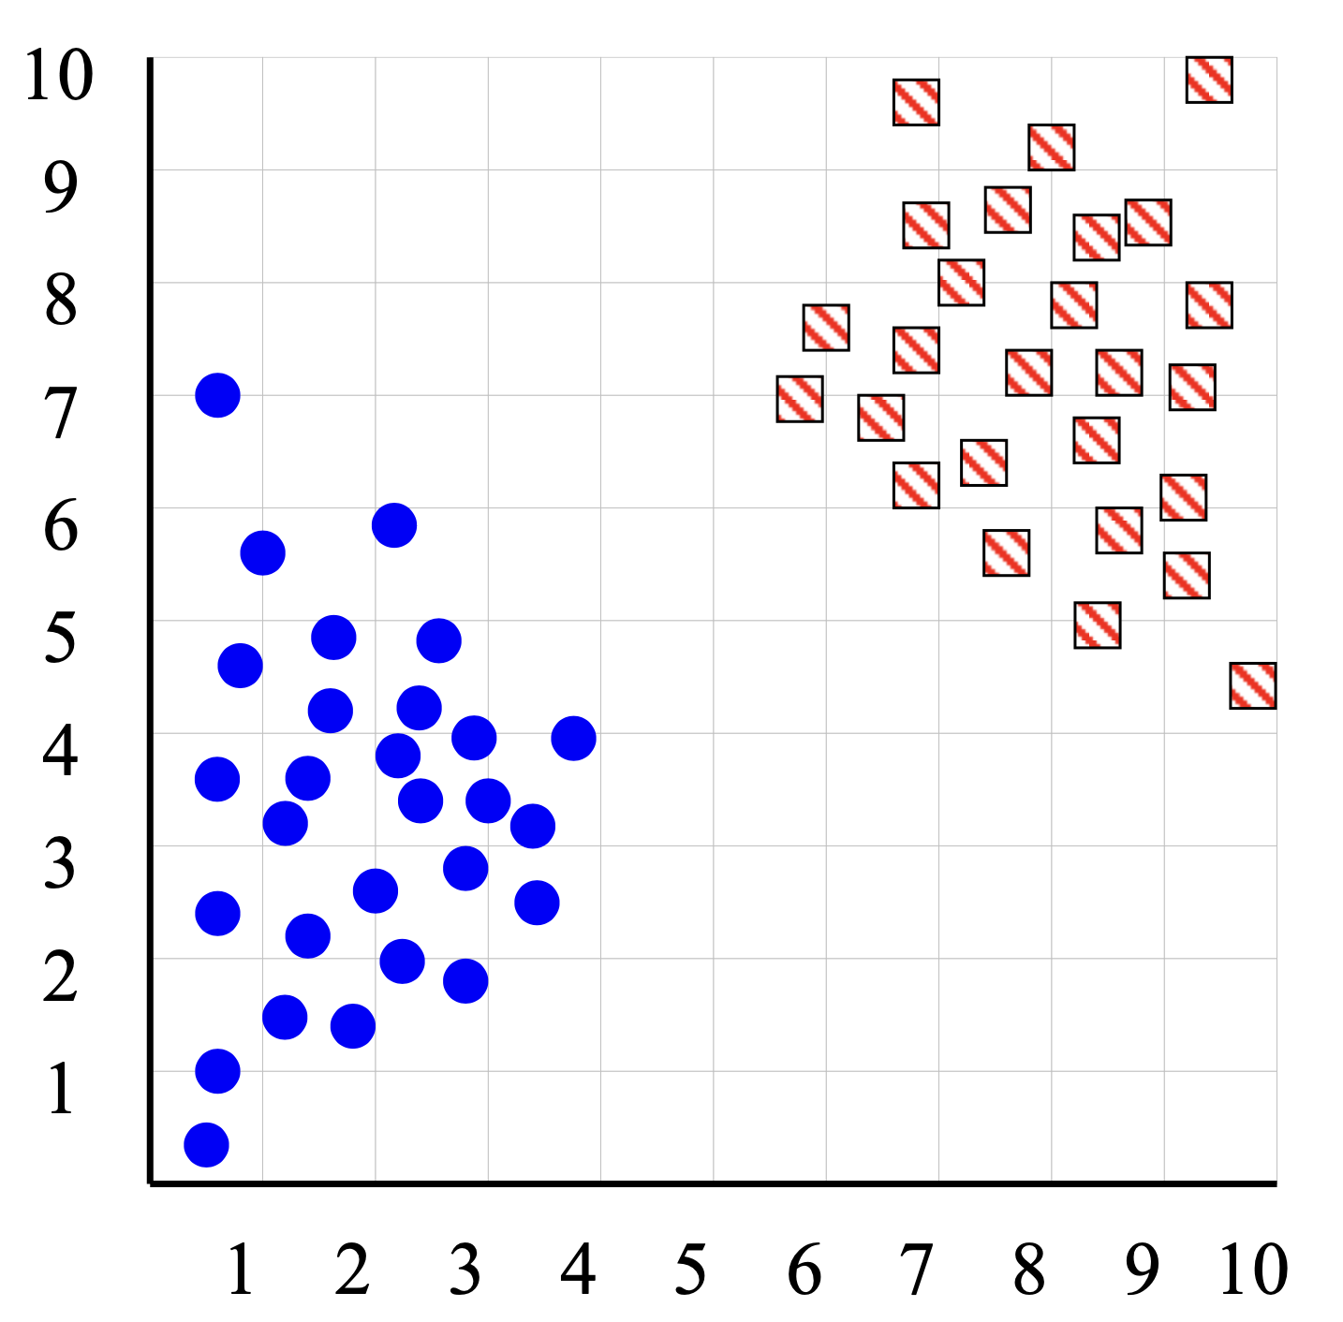
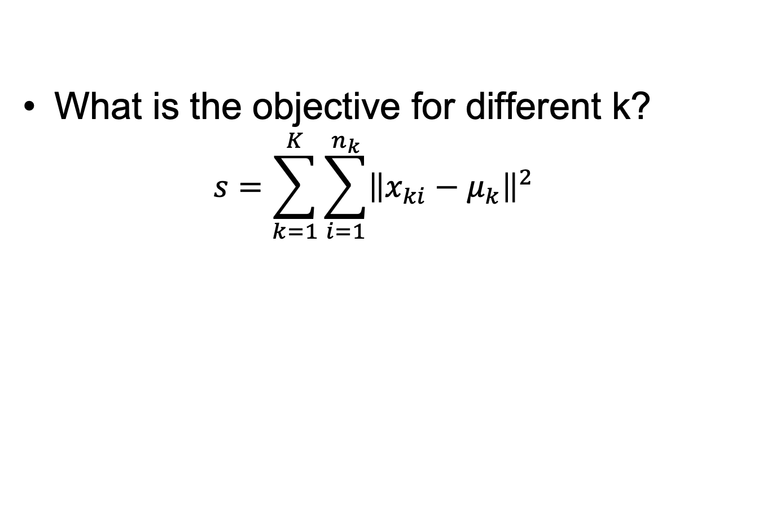
How to decide the number of clusters?
What is the objective for different k?
$$s=\sum_{k=1}^{K}{\sum_{i=1}^{n_{k}}{{\left\|x_{ki}−μ_{k}\right\|}^{2}}}$$

Slide 30
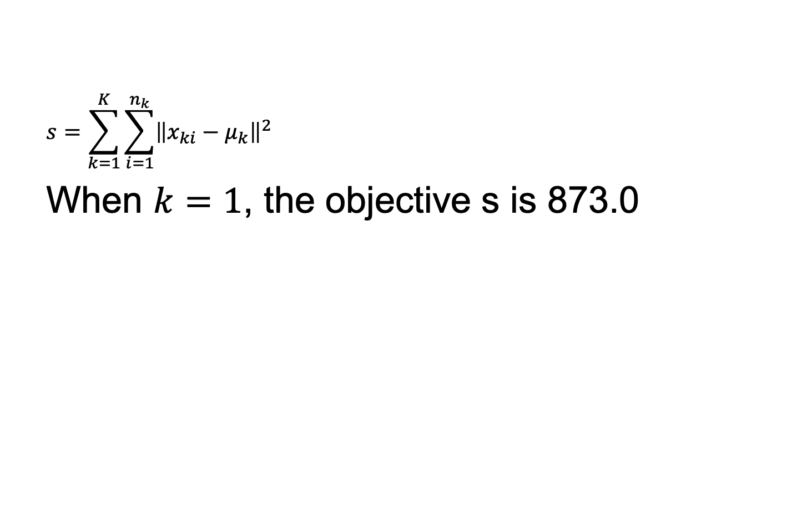
How to decide the number of clusters?
$$s=\sum_{k=1}^{K}{\sum_{i=1}^{n_{k}}{{\left\|x_{ki}−μ_{k}\right\|}^{2}}}$$
When $k=1$, the objective s is 873.0

Slide 31
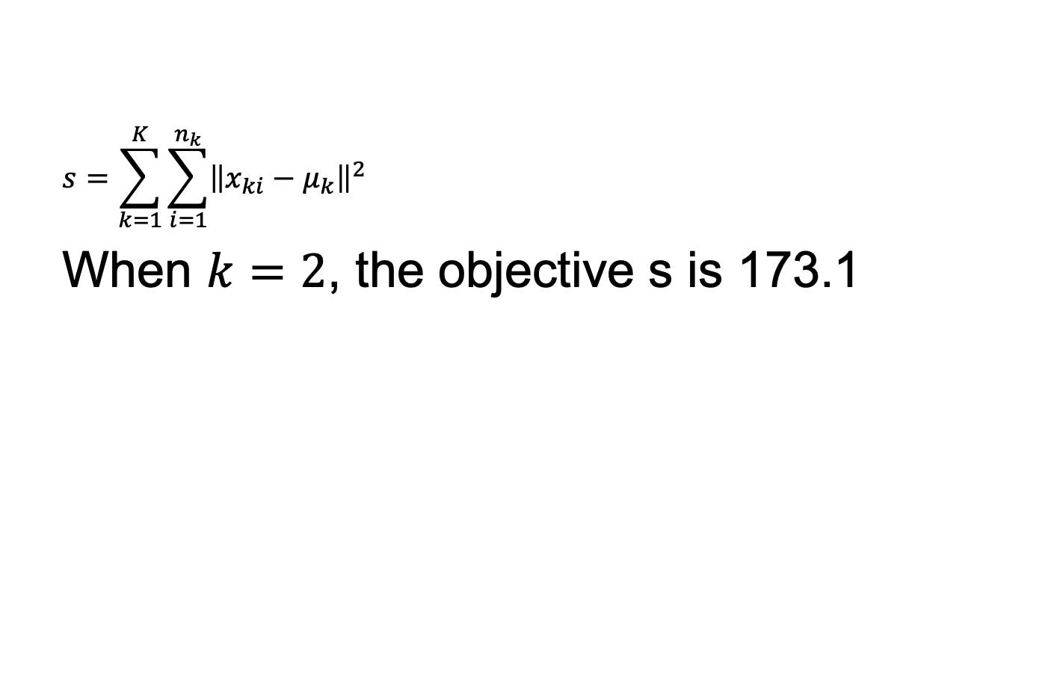
How to decide the number of clusters?
$$s=\sum_{k=1}^{K}{\sum_{i=1}^{n_{k}}{{\left\|x_{ki}−μ_{k}\right\|}^{2}}}$$
When $k=2$, the objective s is 173.1

Slide 32
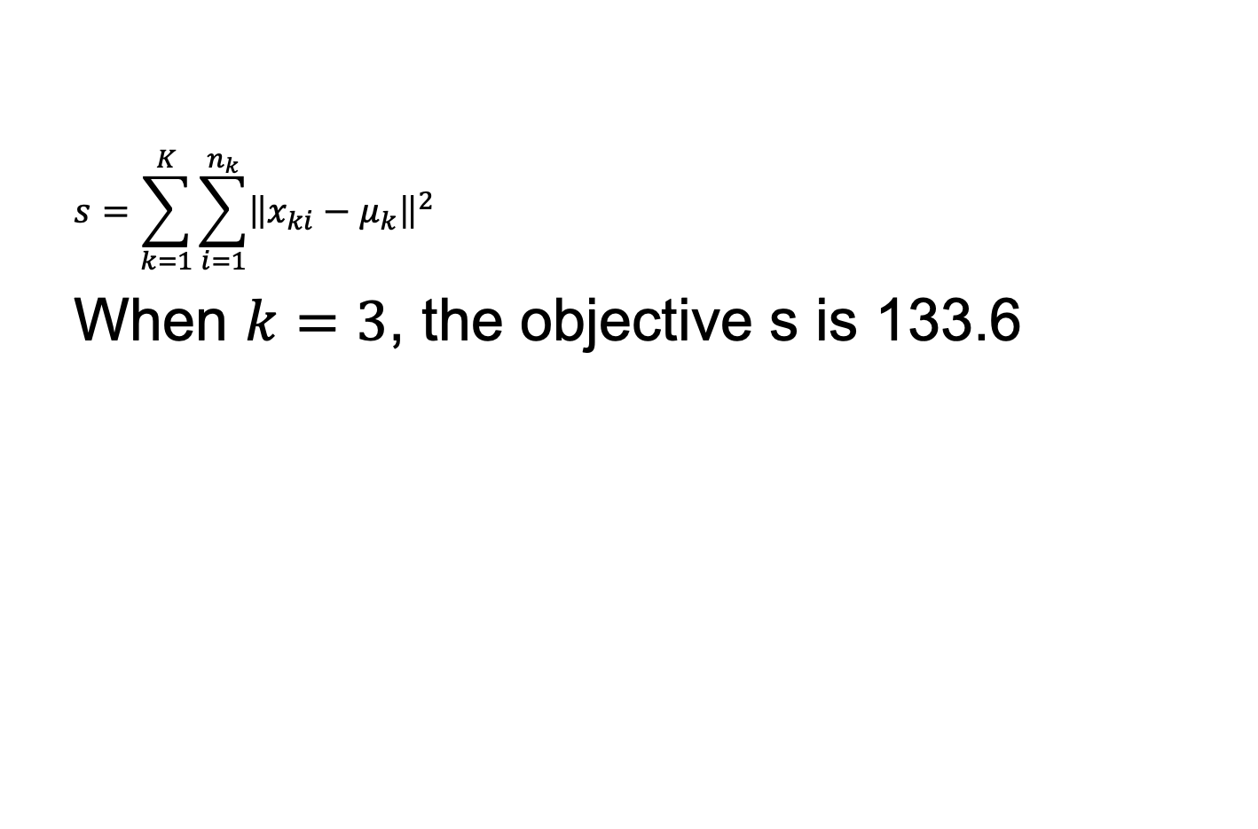
How to decide the number of clusters?
$$s=\sum_{k=1}^{K}{\sum_{i=1}^{n_{k}}{{\left\|x_{ki}−μ_{k}\right\|}^{2}}}$$
When $k=3$, the objective s is 133.6

Slide 33
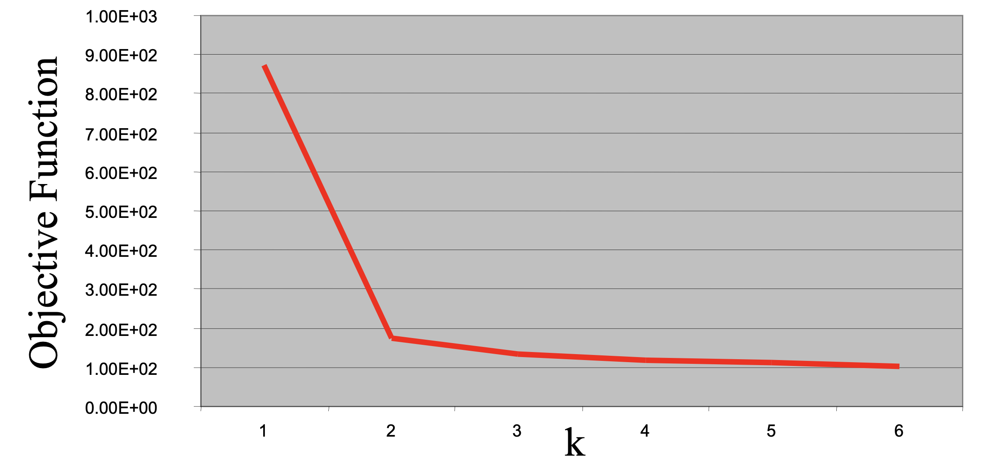
Is larger K always better?
It is not always obvious to choose the right K in high-dimensional data.
“Knee finding”- abrupt change of objective at k=2

Slide 34
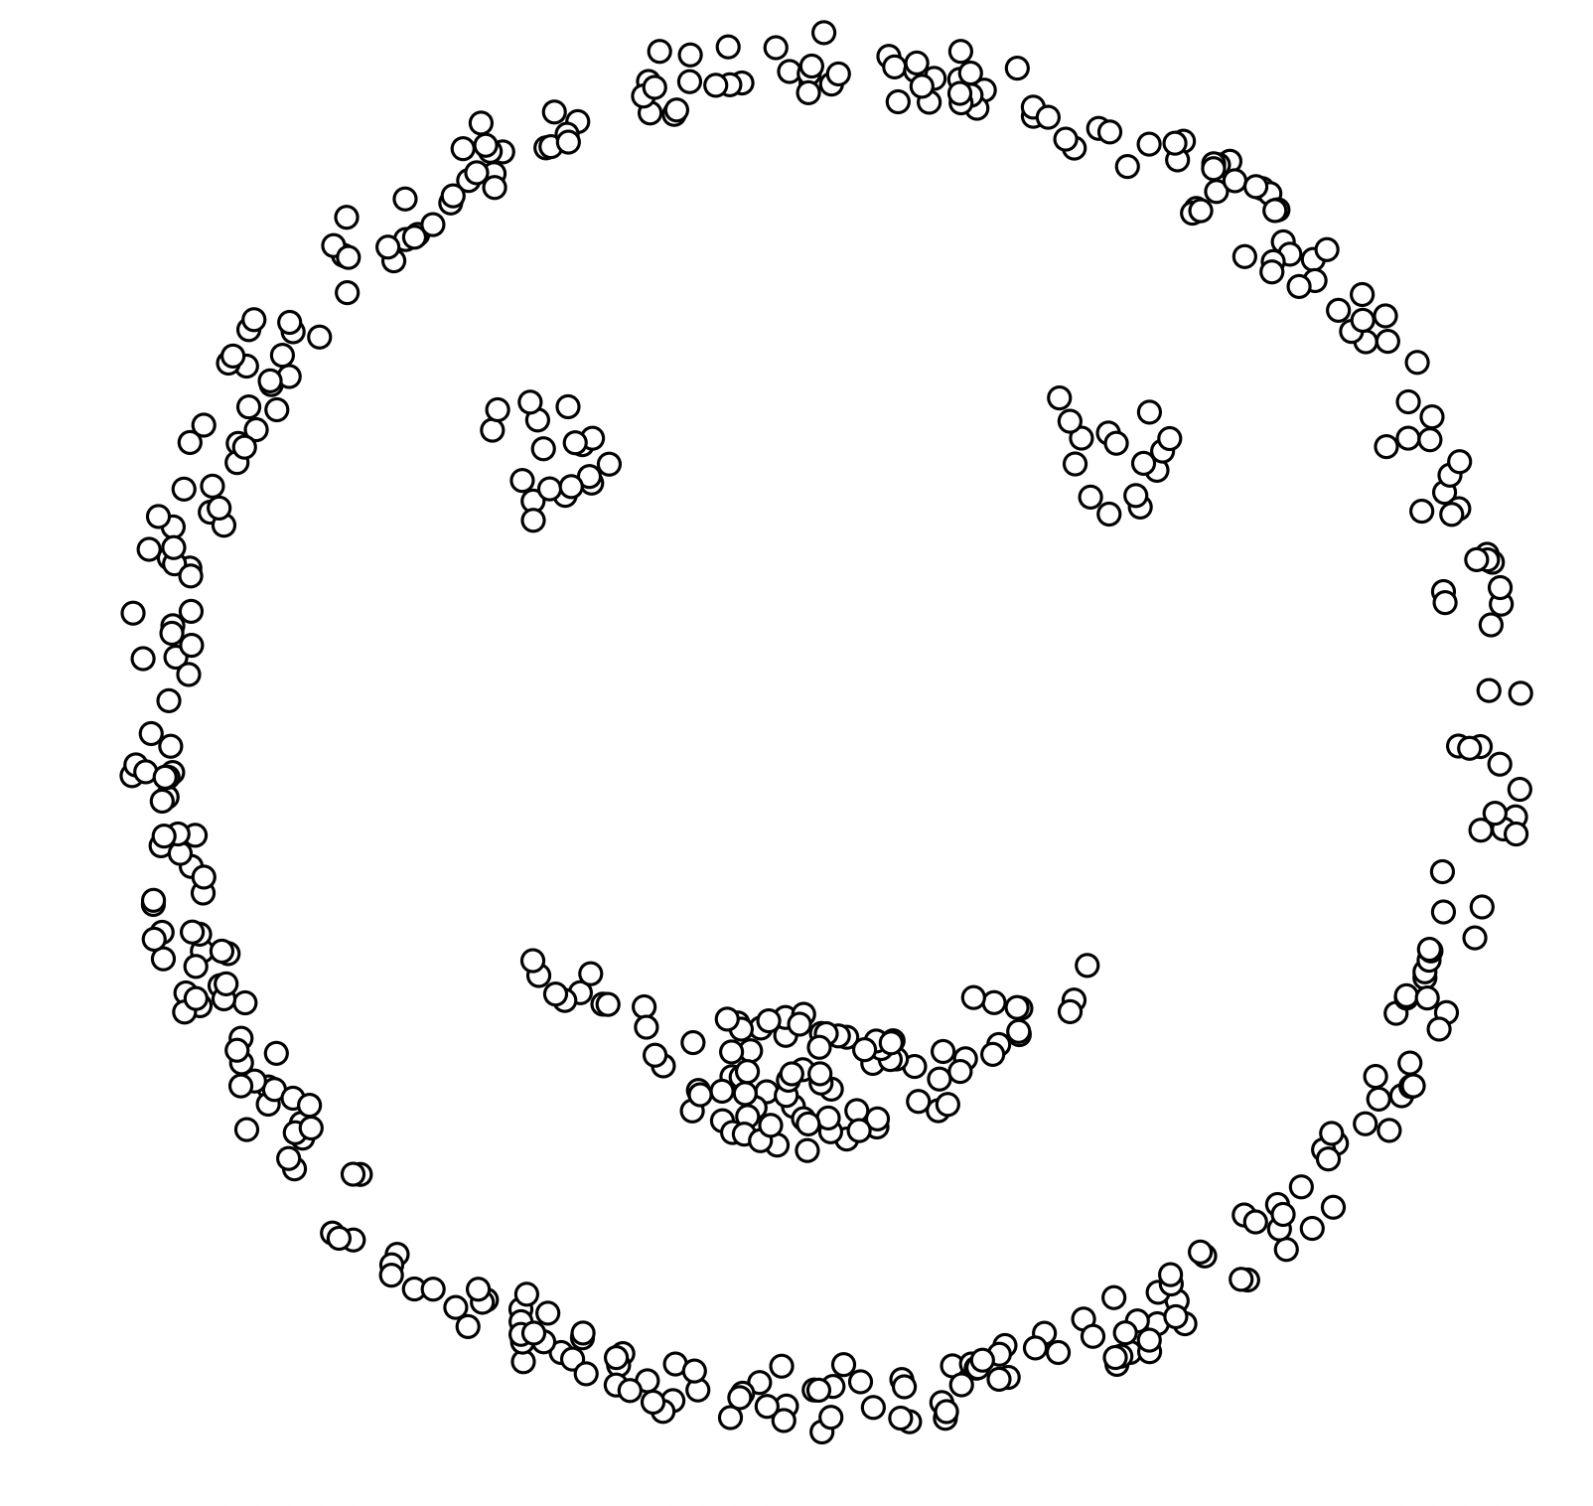
When K-Means fails?

Slide 35
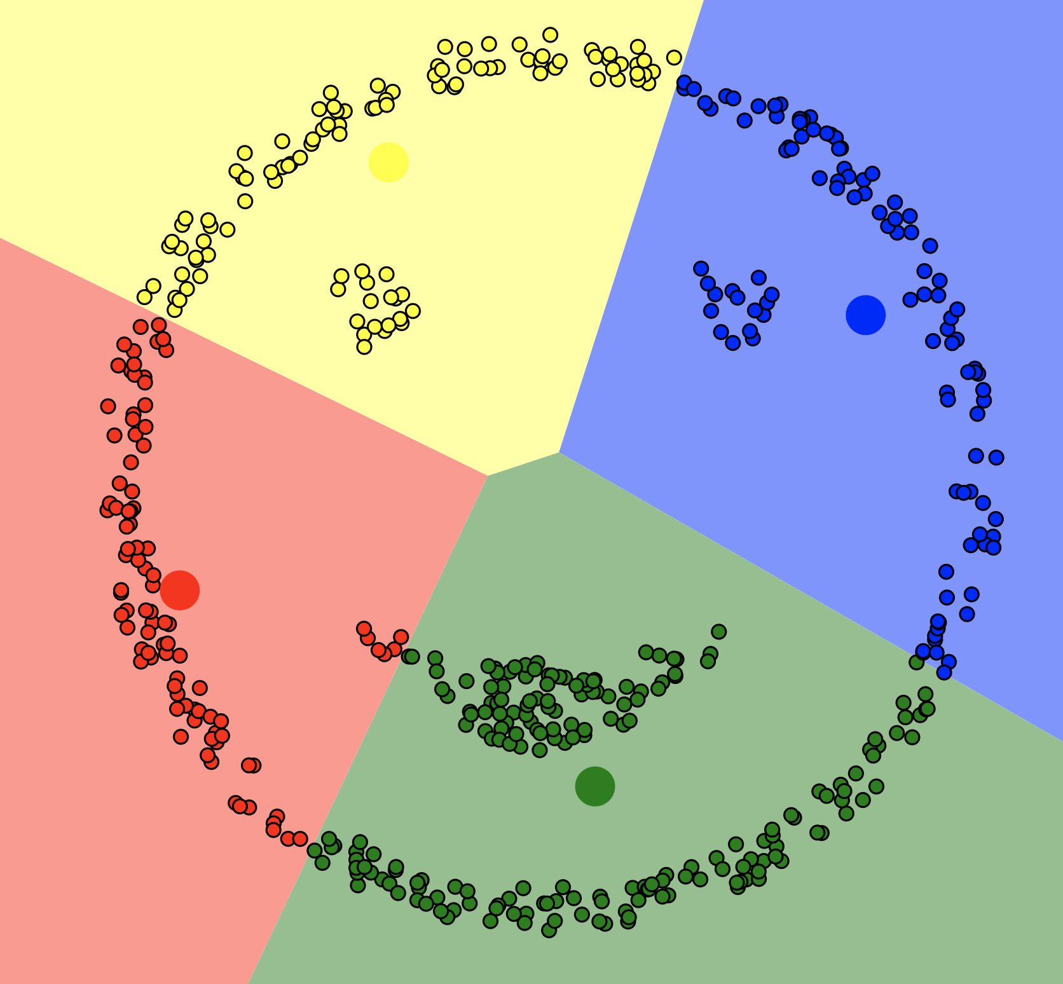
Even setting the right K, K-Means could not find the right clusters!

Slide 36
Summary: K-Means Clustering
Strength
Simple, easy to implement and debug
Intuitive objective function: optimizing intra-cluster similarity
Efficient: complexity ?
Weakness
Applicable only when mean can be calculated
What about Categorical data?
Terminates at a local optimum.
Initialization is important
Sensitive to noisy data and outliers
Not able to find clusters with non-convex shape

Slide 37
Dimensionality Reduction
High-dimensional data
Document classification/clustering: How many features to represent a document?
Words (unigram), bigrams, n-gram
Features for representing a user on Youtube?
Each visited video id can be features

Slide 38
Curse of Dimensionality
Why are more features bad?
Redundant/noisy/useless features
Need more storage space and computation
More model parameters (even if using decision trees or linear models)
Impossible to visualize (> 3 dims)
As dimensionality increases, the distances between data points are indifferent.

Slide 39
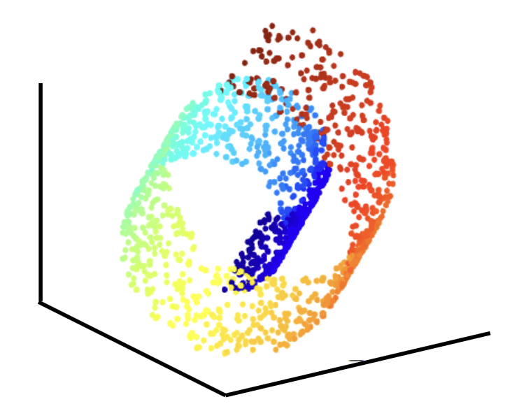
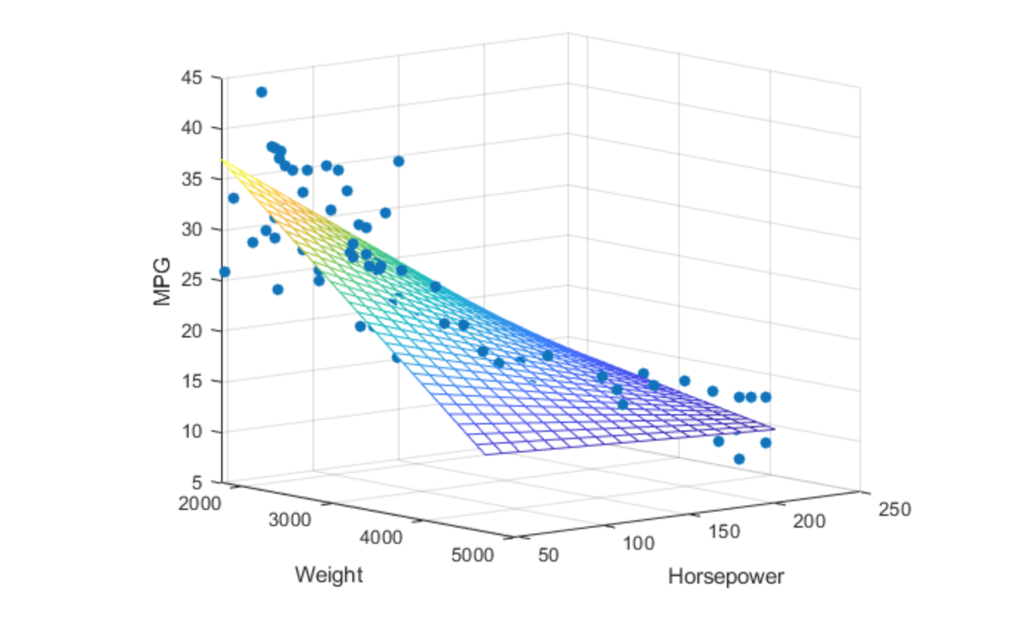
Dimensionality Reduction
Reveal latent features
Assuming data points stay in a low-dimensional manifold

Slide 40
Latent Space
A linear/nonlinear combination of features that capture essential factors of data
Do not necessarily have physical meaning
Linear
Nonlinear

Slide 41
Dimensionality Reduction
Linear:
Principal Component Analysis (PCA)
Independent Component Analysis (ICA)
Non-negative matrix factorization (NMF)
Nonlinear:
Kernel PCA
Local Linear Embedding (LLE)
t-distributed Stochastic Neighbor Embedding (T-SNE)
UMAP

Slide 42
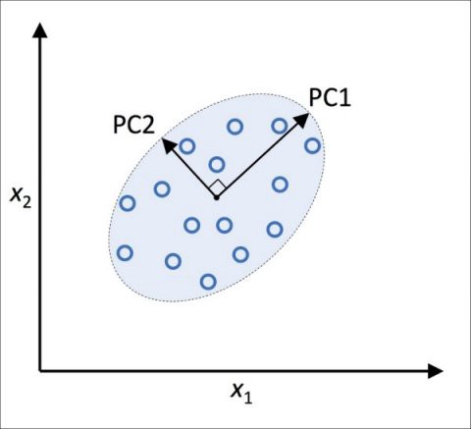
Principal Component Analysis
Assuming data lie in a linear low dimensional subspace
Axes of this subspace are known as principal components

Slide 43
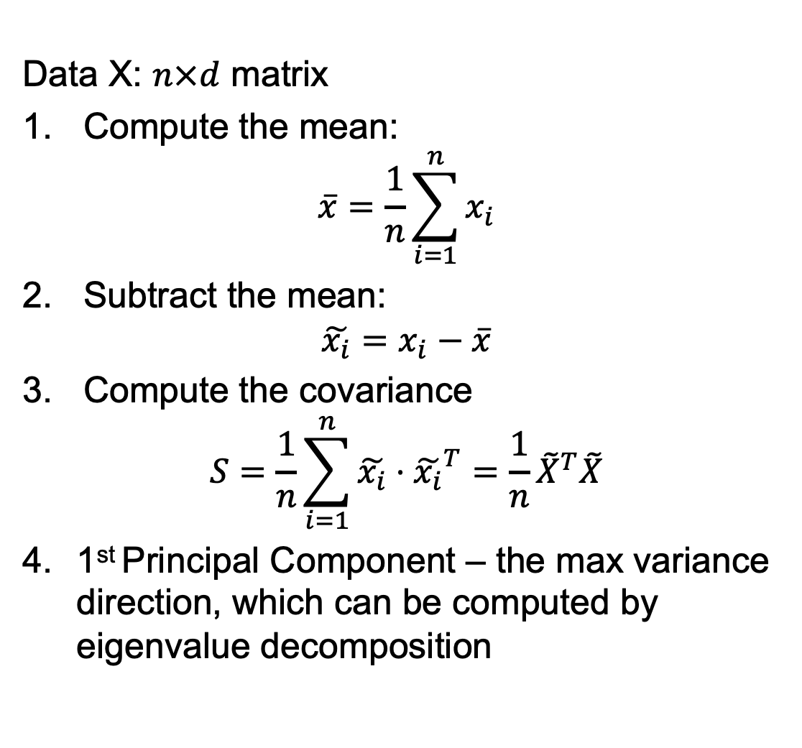
Principal Component Analysis
Data X: $n×d$ matrix
Compute the mean:
$$\overline{x}=\frac{1}{n}\sum_{i=1}^{n}{x_{i}}$$
Subtract the mean:
$$\tilde{x_{i}}=x_{i}−\overline{x}$$
Compute the covariance
$$S=\frac{1}{n}\sum_{i=1}^{n}{\tilde{x_{i}}⋅{\tilde{x_{i}}}^{T}}={\frac{1}{n}\tilde{X}}^{T}\tilde{X}$$
1st Principal Component – the max variance direction, which can be computed by eigenvalue decomposition

Slide 44
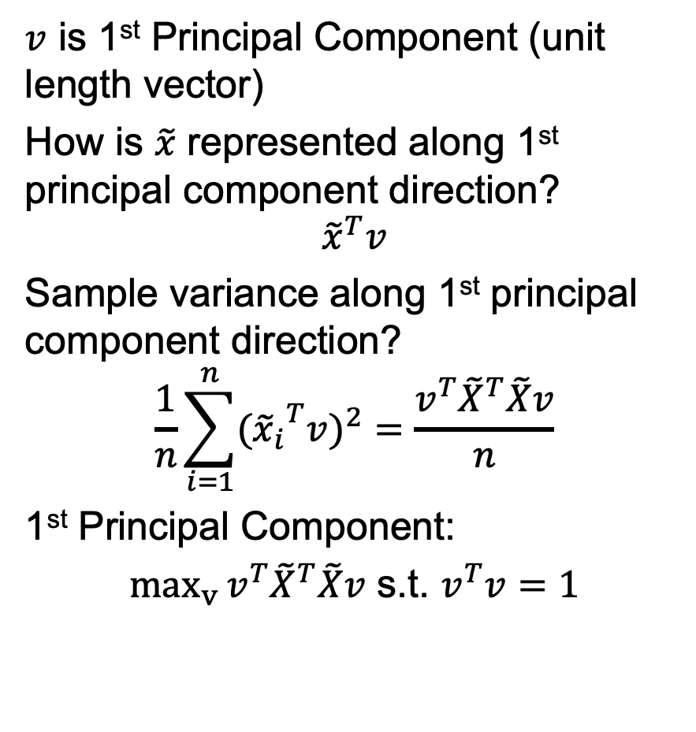
Principal Component Analysis
$v$ is 1st Principal Component (unit length vector)
How is $\tilde{x}$ represented along 1st principal component direction?
$${\tilde{x}}^{T}v$$
Sample variance along 1st principal component direction?
$$\frac{1}{n}\sum_{i=1}^{n}{{{({\tilde{x}}_{i}}^{T}v)}^{2}}=\frac{v^{T}{\tilde{X}}^{T}\tilde{X}v}{n}$$
1st Principal Component:
$\max_{v}{v^{T}{\tilde{X}}^{T}\tilde{X}v}$ s.t. $v^{T}v=1$

Slide 45
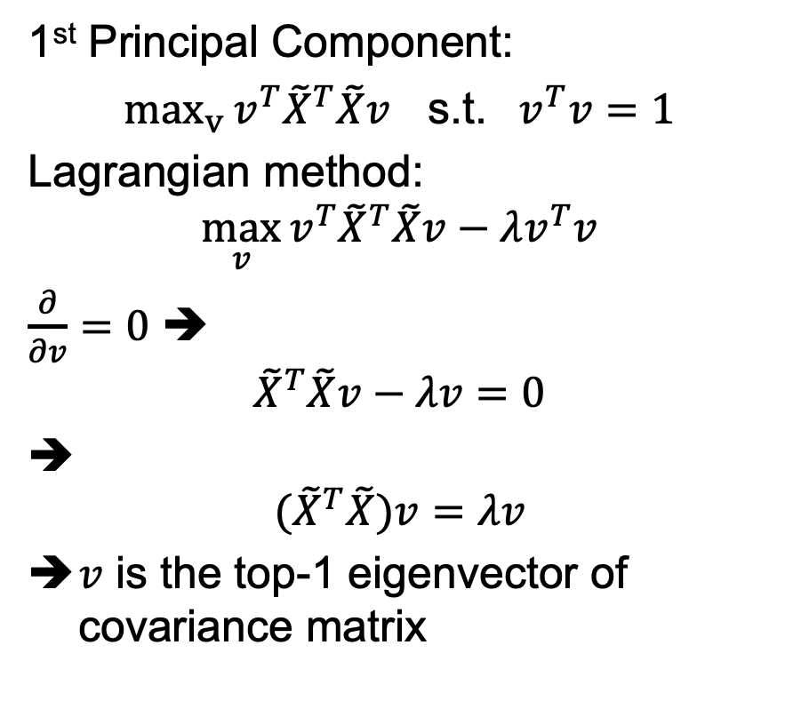
Principal Component Analysis
1st Principal Component:
$\max_{v}{v^{T}{\tilde{X}}^{T}\tilde{X}v}$ s.t. ${ v}^{T}v=1$
Lagrangian method:
$$\max_{v}{v^{T}{\tilde{X}}^{T}\tilde{X}v−λv^{T}v}$$
$\frac{∂}{∂v}=0$ ➔
$${\tilde{X}}^{T}\tilde{X}v−λv=0$$
➔
$${(\tilde{X}}^{T}\tilde{X})v=λv$$
$v$ is the top-1 eigenvector of covariance matrix

Slide 46
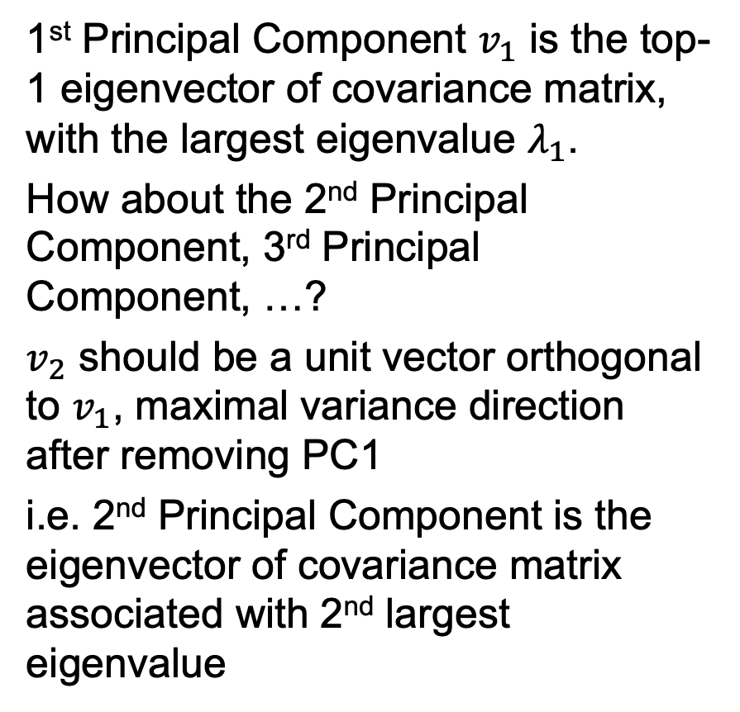
Principal Component Analysis
1st Principal Component $v_{1}$ is the top-1 eigenvector of covariance matrix, with the largest eigenvalue $λ_{1}$.
How about the 2nd Principal Component, 3rd Principal Component, …?
$v_{2}$ should be a unit vector orthogonal to $v_{1}$, maximal variance direction after removing PC1
i.e. 2nd Principal Component is the eigenvector of covariance matrix associated with 2nd largest eigenvalue

Slide 47
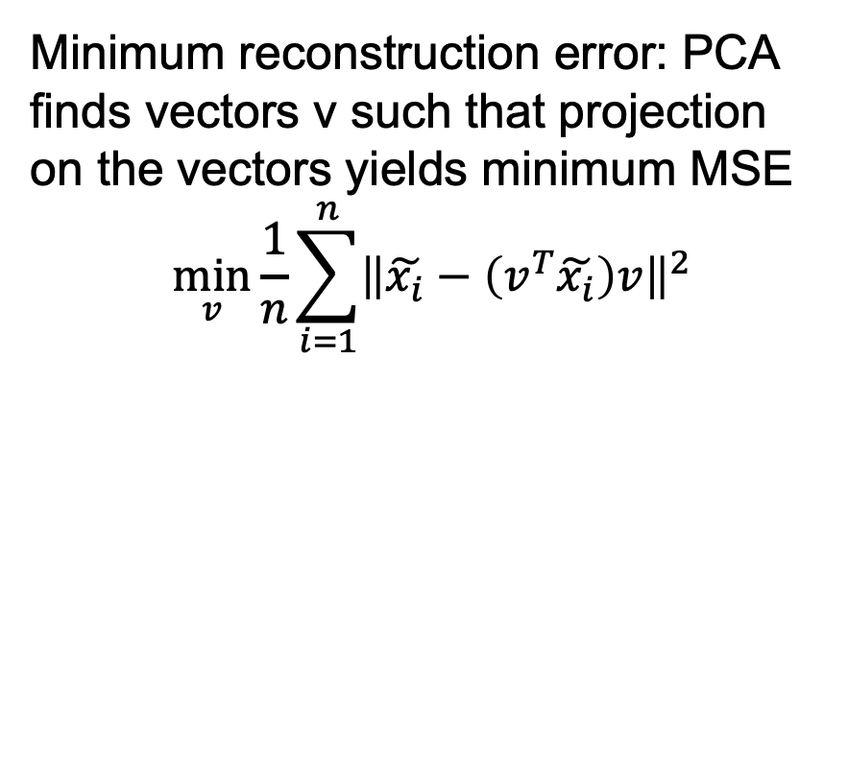
Alternative Interpretation
Minimum reconstruction error: PCA finds vectors v such that projection on the vectors yields minimum MSE
$$\min_{v}{\frac{1}{n}\sum_{i=1}^{n}{{\left\|\tilde{x_{i}}−\left(v^{T}\tilde{x_{i}}\right)v\right\|}^{2}}}$$

Slide 48
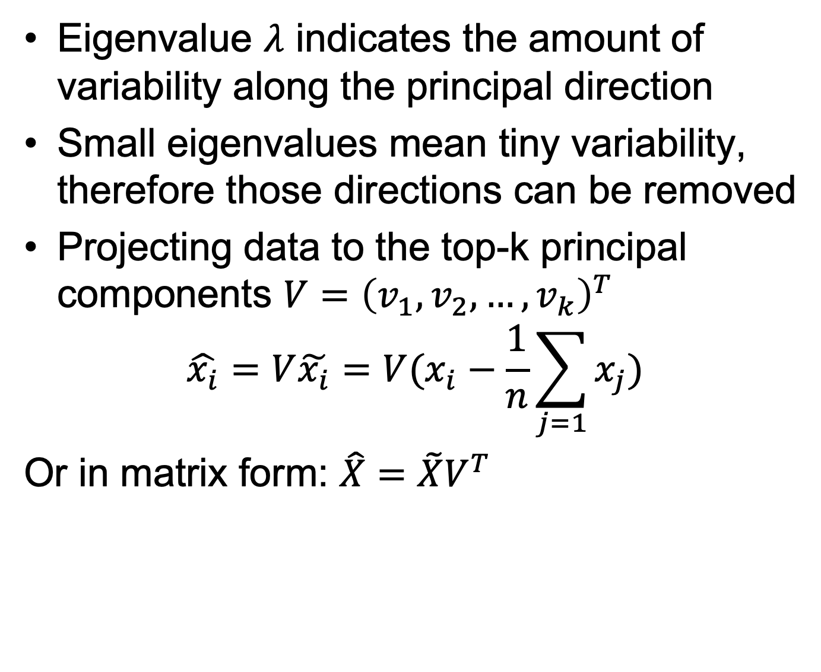
Dimensionality Reduction using PCA
Eigenvalue $λ$ indicates the amount of variability along the principal direction
Small eigenvalues mean tiny variability, therefore those directions can be removed
Projecting data to the top-k principal components $V={\left(v_{1},v_{2}, …,v_{k}\right)}^{T}$
$$\hat{x_{i}}=V\tilde{x_{i}}=V(x_{i}−\frac{1}{n}\sum_{j=1}{x_{j}})$$
Or in matrix form: $\hat{X}=\tilde{X}V^{T}$

Slide 49
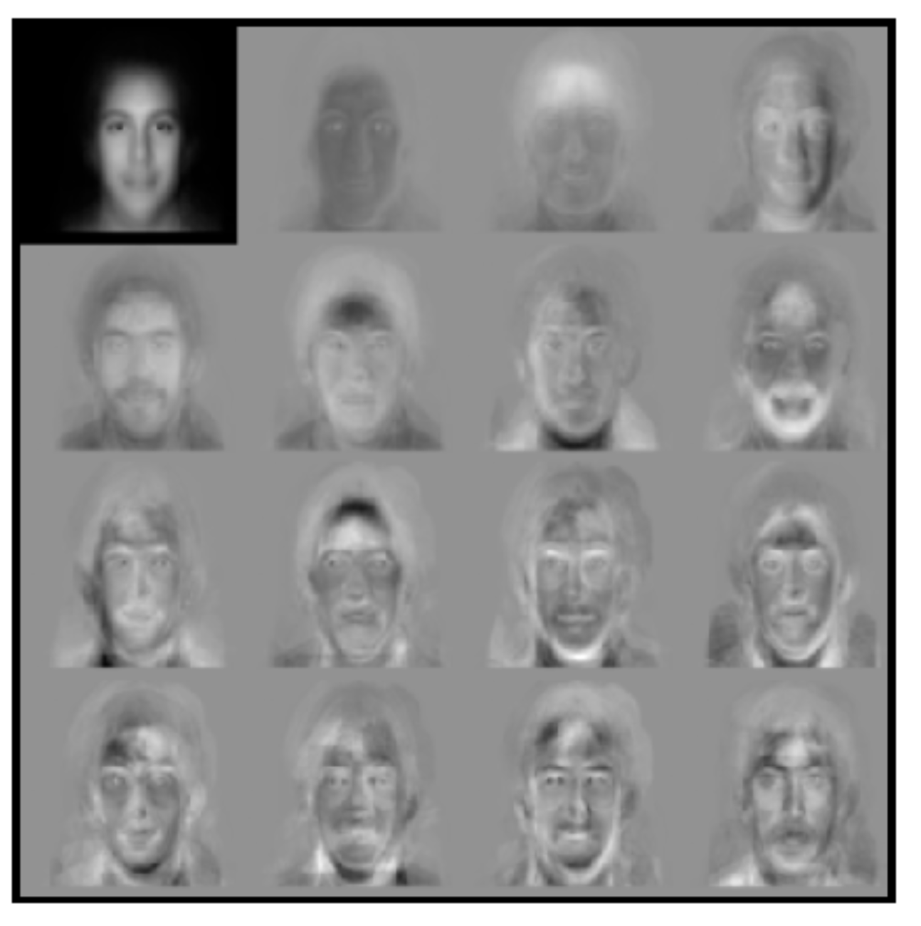
Example: Eigenface
Data: 7562 images of human faces
Top left image is linear combination of the rest.
Independently developed by
Sirovich and Kirby, 1987
Turk and Pentland, 1991

Slide 50
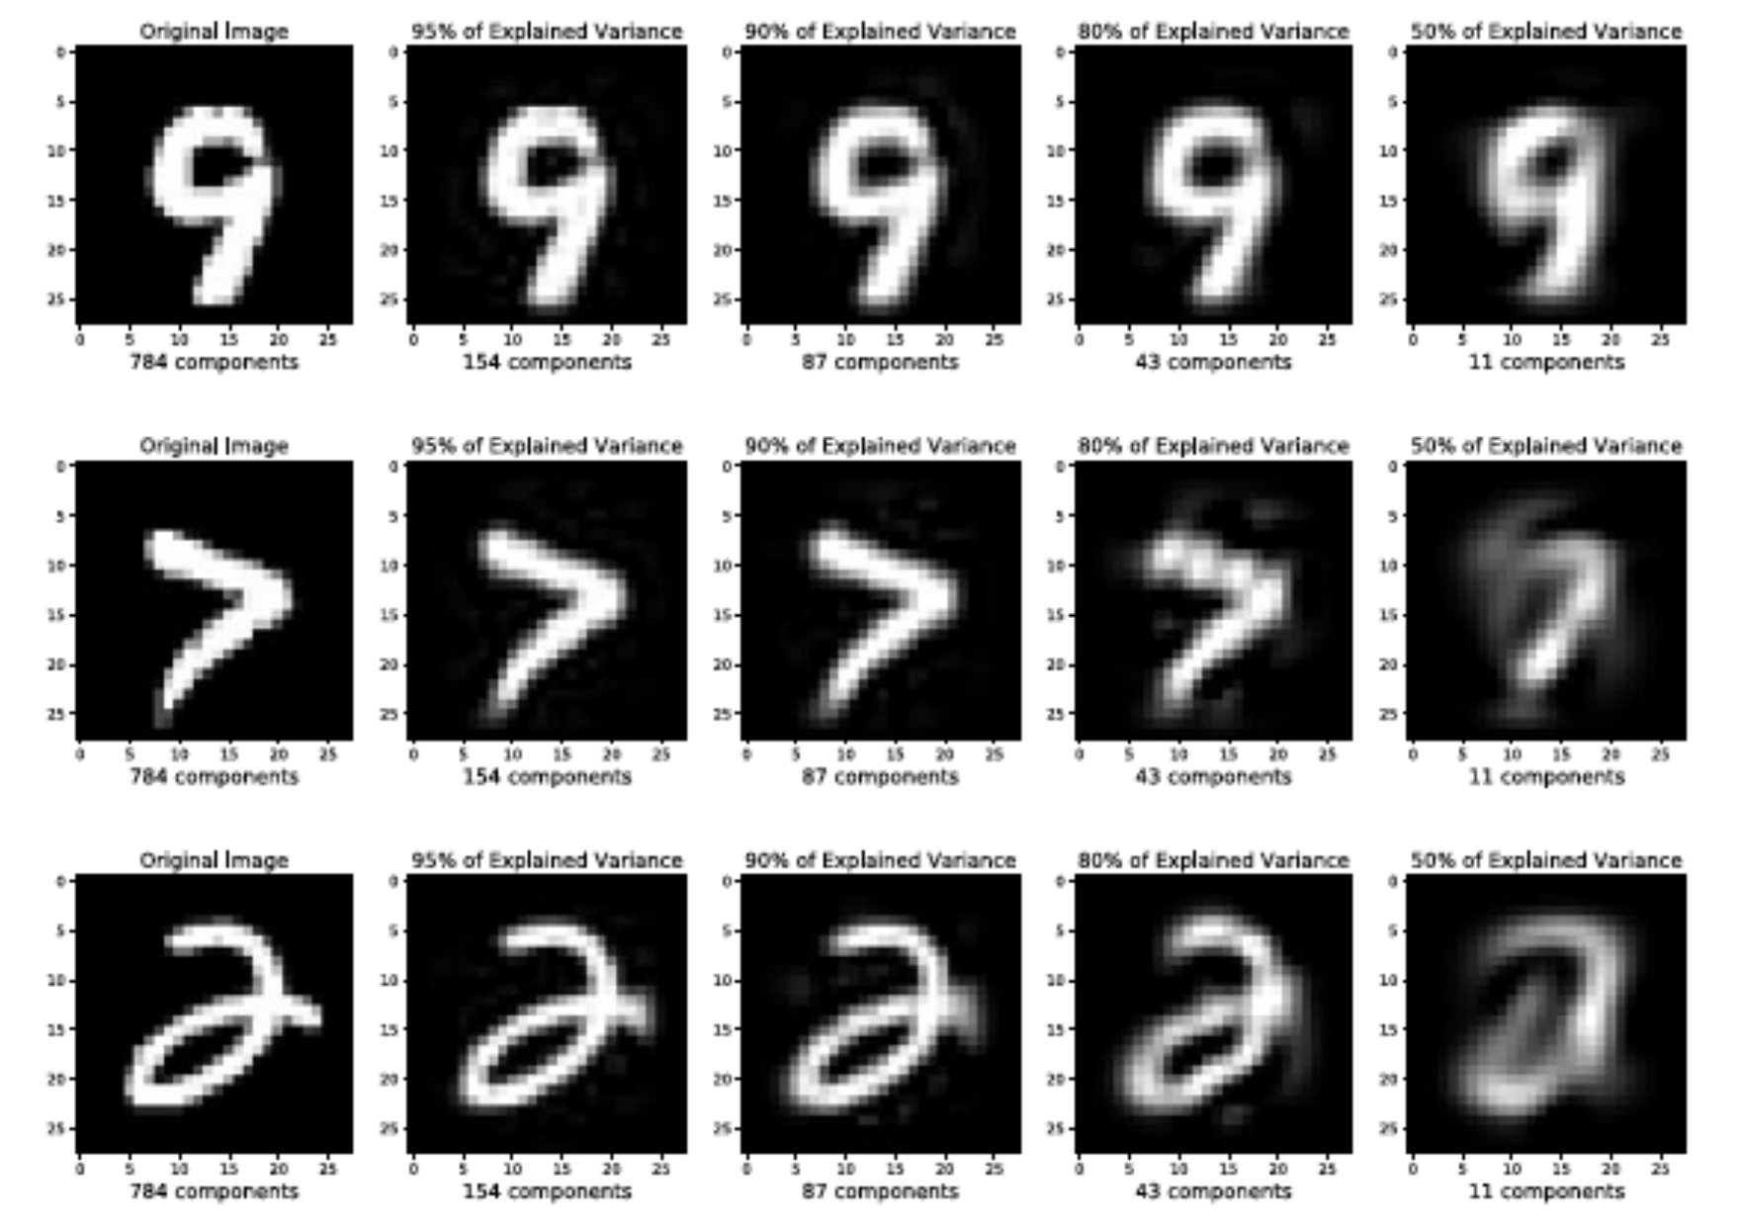
Example: handwritten digits
MNIST dataset: 28 x 28 images of digits
Project to k dimensional principal components and then reconstruct to original space

Slide 51
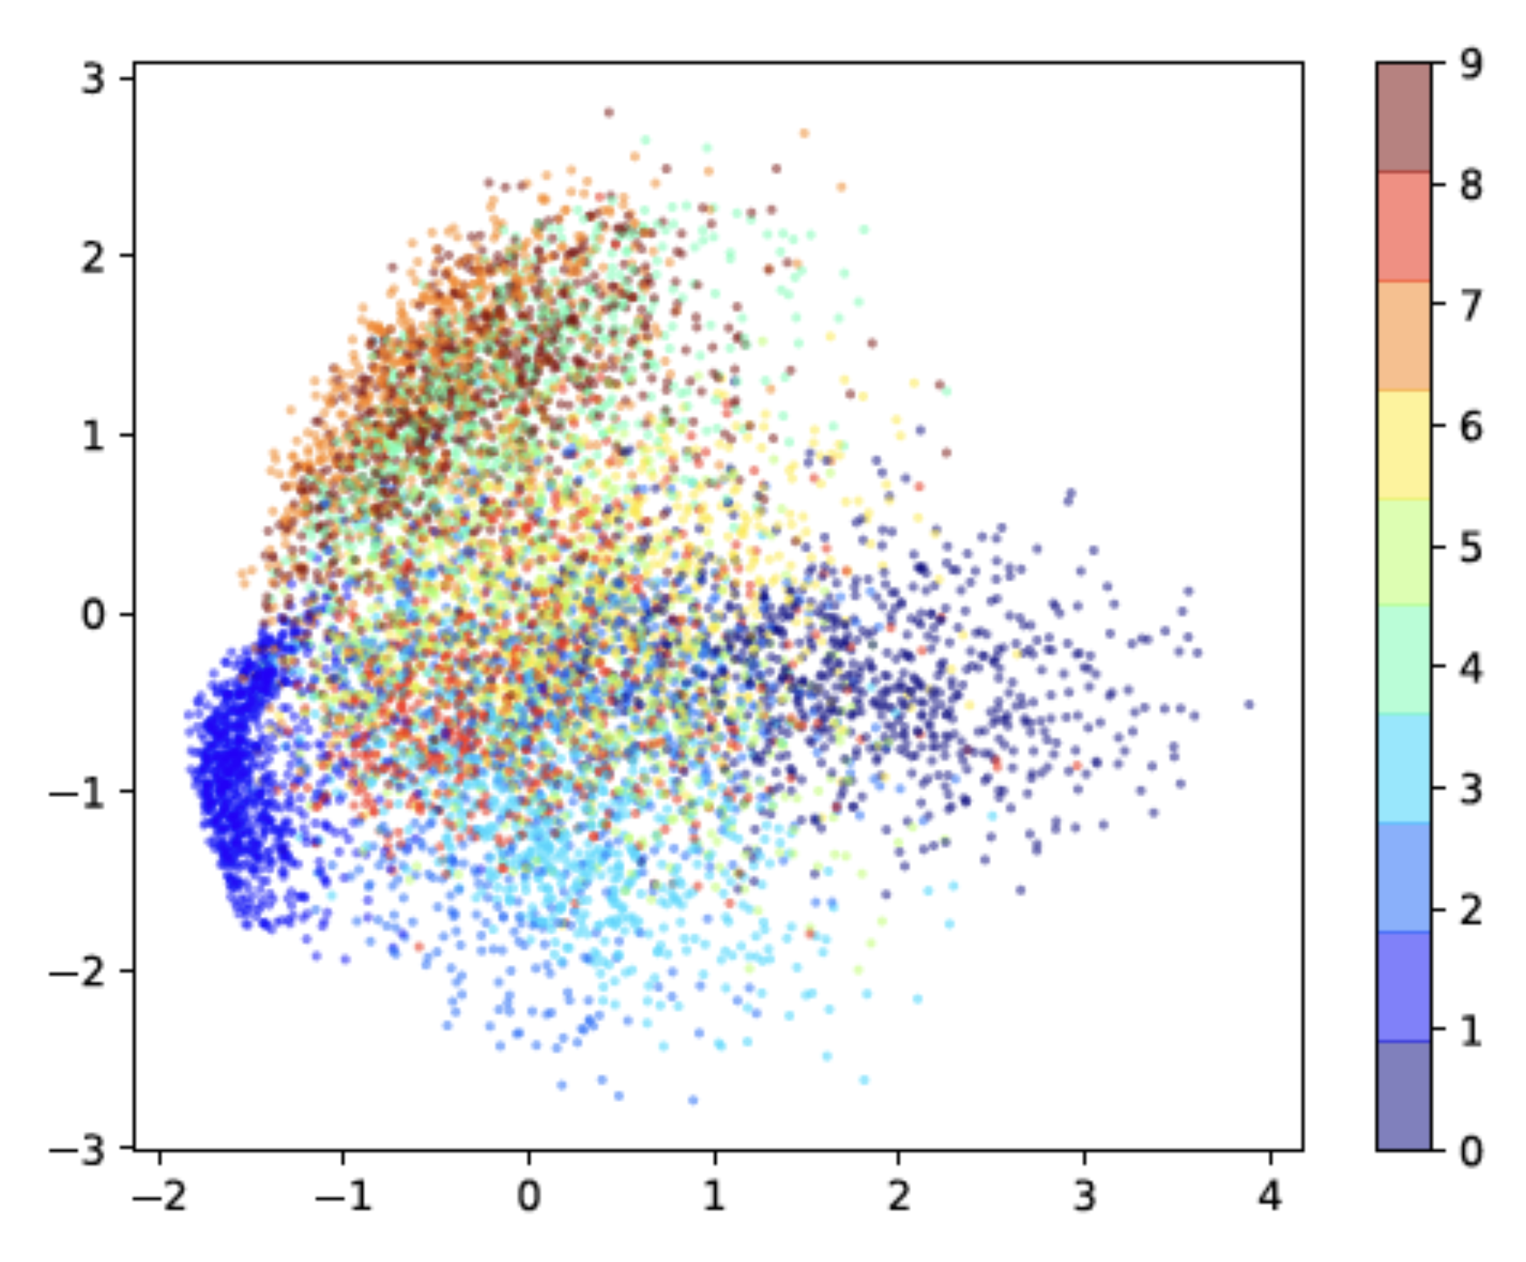
Visualizing MNIST in 2D

Slide 52
Interactive Illustration
https://setosa.io/ev/principal-component-analysis/

Slide 53
Properties of PCA
Advantage:
Eigen decomposition, O(n³)
No need to tune parameters
Weaknesses
Linear projection
Second-order statistics (covariance)

Slide 54
Computing PCA with Python
def pca(X):
# Data matrix X, assumes 0-centered
n, m = X.shape
# Compute covariance matrix
S = numpy.dot(X.T, X) / n
# Eigen decomposition
eigen_vals, eigen_vecs = numpy.linalg.eig(S)
# Project X onto PC space
X_pca = numpy.dot(X, eigen_vecs)
return X_pca

Slide 55
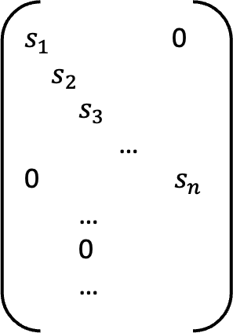
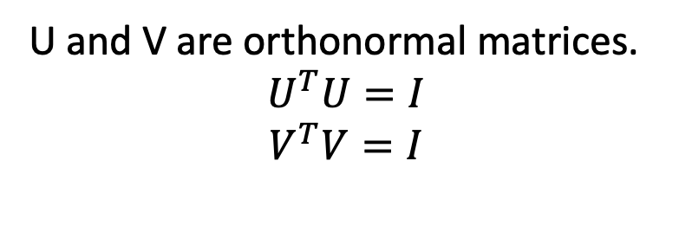
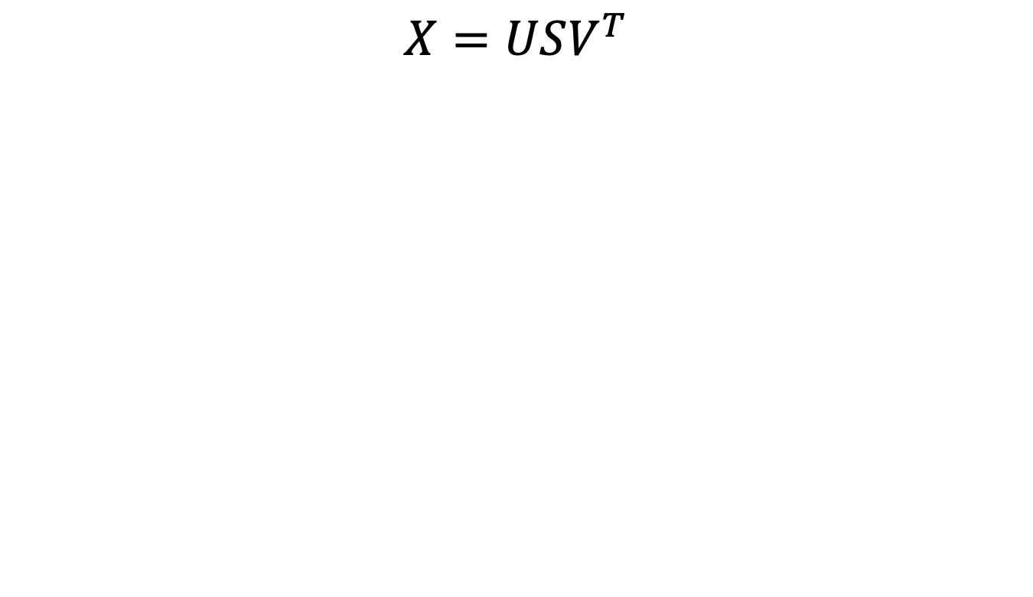
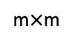
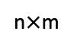
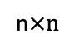
Singular Value Decomposition
$$X=USV^{T}$$
x
U
$s_{1}$ 0
$s_{2}$
$s_{3}$
…
0 $s_{n}$
…
0
…
V
=
m$×$m
n$×n$
n$×$m
U and V are orthonormal matrices.
$$U^{T}U=I$$
$$V^{T}V=I$$
Diagonal matrix with singular values (ordered)

Slide 56
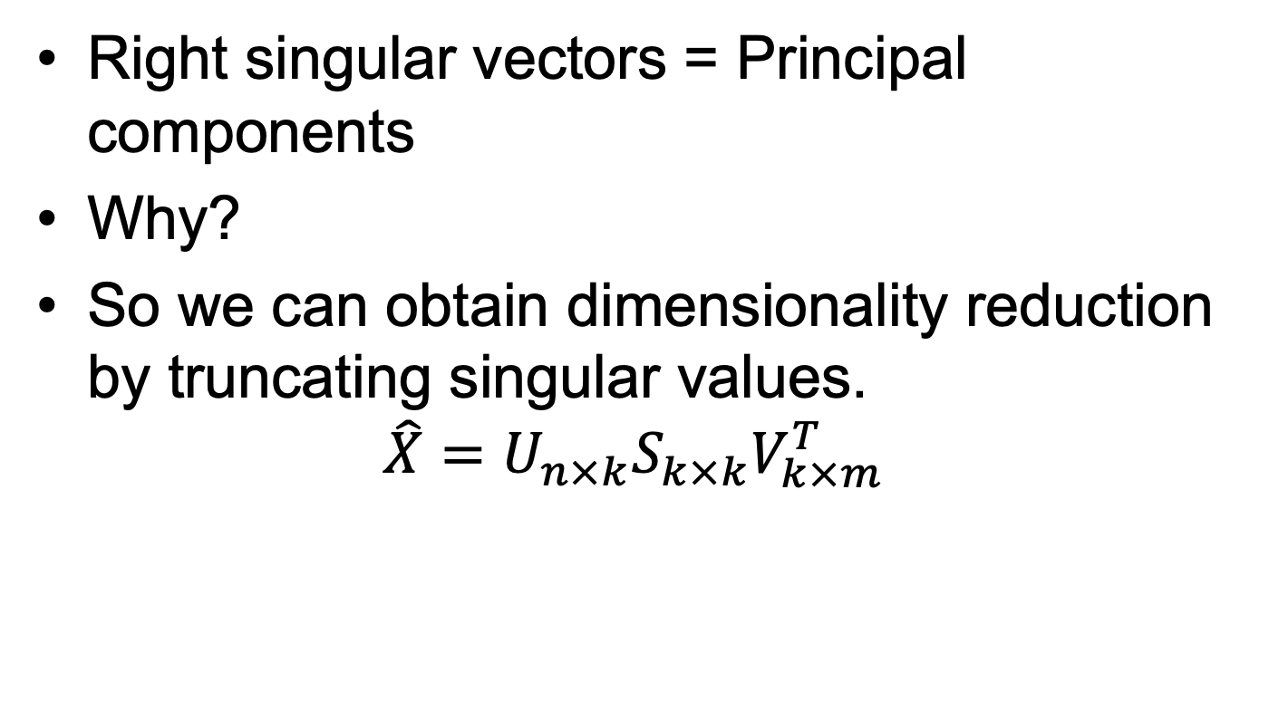
Relation between SVD and PCA
Right singular vectors = Principal components
Why?
So we can obtain dimensionality reduction by truncating singular values.
$$\hat{X}=U_{n×k}S_{k×k}V_{k×m}^{T}$$

Slide 57




Dimensionality Reduction by SVD
$$\hat{X}=U_{n×k}S_{k×k}V_{k×m}^{T}$$
x
U
$s_{1}$ 0
$s_{2}$
$s_{3}$
…
0 $s_{n}$
…
0
…
V^{T}
=
m$×$m
n$×n$
n$×$m

Slide 58
SVD and PCA
PCA can be computed using SVD
Computing SVD with top-k singular values is faster than PCA with eigen decomposition.
SVD can be used to compute the pseudo-inverse of a rectangular matrix

Slide 59

Summary: Dimensionality Reduction
Principal Component Analysis
Center the data by subtracting the mean
Compute covariance matrix $S={\frac{1}{n}\tilde{X}}^{T}\tilde{X}$
Eigen decomposition on covariance matrix
Eigenvectors are principal components, eigenvalues are energy
Singular Value Decomposition
Can be used to compute PCA, and faster
Reduce the dimension by truncating at top-k singular values. $\hat{X}=U_{n×k}S_{k×k}V_{k×m}^{T}$

